Slide 1
Introduction to IEEE
<audience/event> < date> <Name> <Title> <IEEE Organizational Unit>
Notes:
Updated on 24 May 2024
Presentation Templates prepared by Ewell Tan, IEEE Asia-Pacific Limited

Slide 2
Content
About IEEE
Mission Statement
Vision Statement
IEEE at a Glance
The Organization

Slide 3
About IEEE
IEEE is the world's largest technical professional association dedicated to advancing technological innovation and excellence for the benefit of humanity.
IEEE and its members inspire a global community through IEEE's highly cited publications, conferences, technology standards, and professional and educational activities.

Slide 4
MISSION
IEEE's core purpose is to foster technological innovation and excellence for the benefit of humanity.
VISION
IEEE will be essential to the global technical community and to technical professionals everywhere, and be universally recognized for the contributions of technology and of technical professionals in improving global conditions.

Slide 5
IEEE at a Glance
Over 460,000 members in more than 190 countries, with more than 66 percent from outside the United States
More than 171,000 Student members
344 Sections in ten geographic Regions worldwide
2,709 Chapters that unite local members with similar technical interests
3,635 Student Branches at colleges and universities in over 100 countries
4,194 Student Branch Chapters of IEEE technical societies
639 Affinity Groups;
IEEE affinity groups are non-technical sub-units of one or more Sections or a Council. The affinity group patent entities are the IEEE-USA Consultants' Network, Young Professionals (YP), Women in Engineering (WIE), Life Members (LM).
Notes:
Source: https://www.ieee.org/about/today/at-a-glance.html
Data as of December 2023

Slide 6
IEEE at a Glance (continued:-)
Has 39 Societies and eight Technical Councils representing the wide range of IEEE technical interests
Has more than 6 million documents in the IEEE Xplore® Digital Library
Has an active portfolio of nearly 1,144 standards and more than 1,018 projects under development
Publishes more than 200 transactions, journals and magazines
Sponsors more than 2,000 conferences and events in 190 countries
Notes:
* Source: http://www.ieee.org/about/today/at_a_glance.html
Data as of December 2023

Slide 7
Organization of IEEE
IEEE MEMBERS
IEEE Board
of Directors
Member & Geographic Activities
Board
Educational Activities
Board
IEEE-USA
Board
Publication Services & Products
Board
Standards Association Board
Technical Activities
Board

Slide 8
IEEE Technical Societies
Aerospace and Electronic Systems Society
Antennas and Propagation Society
Broadcast Technology Society
Circuits and Systems Society
Communications Society
Computational Intelligence Society
Computer Society
Consumer Electronics Society
Control Systems Society
Dielectrics and Electrical Insulation Society
Education Society
Electromagnetic Compatibility Society
Electron Devices Society
Electronics Packaging Society
Engineering in Medicine and Biology Society
Geoscience and Remote Sensing Society
Industrial Electronics Society
Industry Applications Society
Information Theory Society
Instrumentation and Measurement Society
Intelligent Transportation Systems Society
Magnetics Society
Microwave Theory and Techniques Society
Nuclear and Plasma Sciences Society
Oceanic Engineering Society
Photonics Society
Power Electronics Society
Power & Energy Society
Product Safety Engineering Society
Professional Communication Society
Reliability Society
Robotics and Automation Society
Signal Processing Society
Society on Social Implications of Technology
Solid-State Circuits Society
Systems, Man, and Cybernetics Society
Technology and Engineering Management Society
Ultrasonics, Ferroelectrics, and Frequency Control Society
Vehicular Technology Society

Slide 9
Total IEEE Membership (1963 – 2023)
as at 31st December 2023

Slide 10
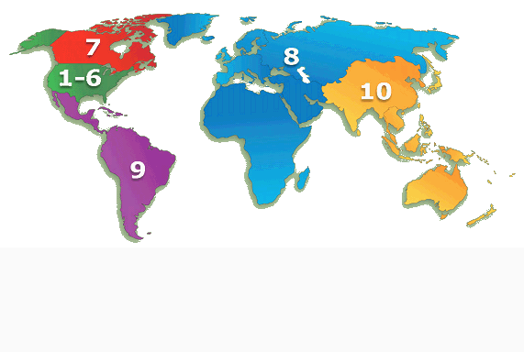
IEEE Membership By Region 31 December 2023
R7 – 14,500
(3.1%)
R10 – 187,221
(40.6%)
R1 to 6 – 153,204
(33.3%)
R1 – 24,638
R2 – 21,355
R3 – 24,907
R4 – 16,987
R5 – 22,701
R6 – 42,616
R8 – 84,337
(18.3%)
Reflecting the global nature of IEEE, R10 and R8 are now the two largest IEEE Regions
R9 – 21,447
(4.7%)
TOTAL MEMBERSHIP – 460,709

Slide 11
IEEE Region 10 (Asia-Pacific Region)
Organizational Units - 31 Dec 2023
Areas
Region 10
Councils
(6)
Sections
(60)
Chapters
(847)
Subsections
(42)
Student Branches
(1,777)
Affinity Groups
(128)
Student Branch
Affinity Groups
(478)
Student Branch
Chapters
(2,257)
Notes:
Geographic Unit Relationships
Regions oversee Sections
Sections oversee Subsections, Chapters, Student Branches and Affinity Groups
Councils are comprised of Sections, and exist at the pleasure of the member Sections

Slide 12
How does IEEE Work?
Volunteers
Staff
Members
Efforts are accomplished through a partnership between Volunteers, Members, and Staff
Volunteers are the key to all IEEE activities

Slide 13
Thank You
Contact:

