Slide 1
IEEE Membership Statistics
(Name)
(Position)
(Date)
Notes:
Updated on 17 May 2024

Slide 2
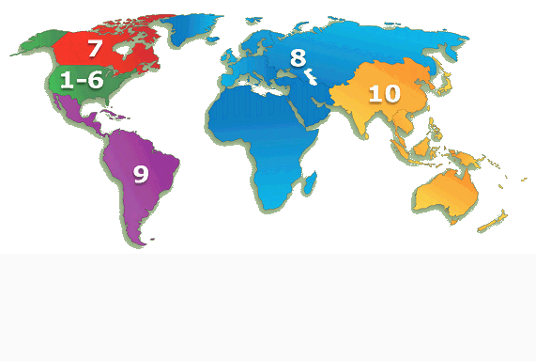

IEEE Membership By Region
31 December 2023
R7 – 14,500
(3.1%)
R10 – 187,221
(40.6%)
R1 to 6 – 153,204
(33.3%)
R1 – 24,638
R2 – 21,355
R3 – 24,907
R4 – 16,987
R5 – 22,701
R6 – 42,616
R8 – 84,337
(18.3%)
Reflecting the global nature of IEEE, R10 and R8 are now the two largest IEEE Regions
R9 – 21,447
(4.7%)
TOTAL MEMBERSHIP – 460,709

Slide 3
IEEE Membership By Region
31 December 2023

Slide 4
Total IEEE Membership (1963 – 2023)
as at 31st December 2023

Slide 5
Total Higher Grade Membership (1963 – 2023)
as at 31st December 2022

Slide 6
Total Student Membership (1963 – 2023)
as at 31st December 2023
Year 2006 - New Record for Student Membership
80,491
Year 2007 was the first year that the IEEE GMS was fully implemented
GSM are voting members = higher grade members

