Slide 1
More Data!
More Headaches!
Exploring techniques for headache relief
Home backup

Slide 2
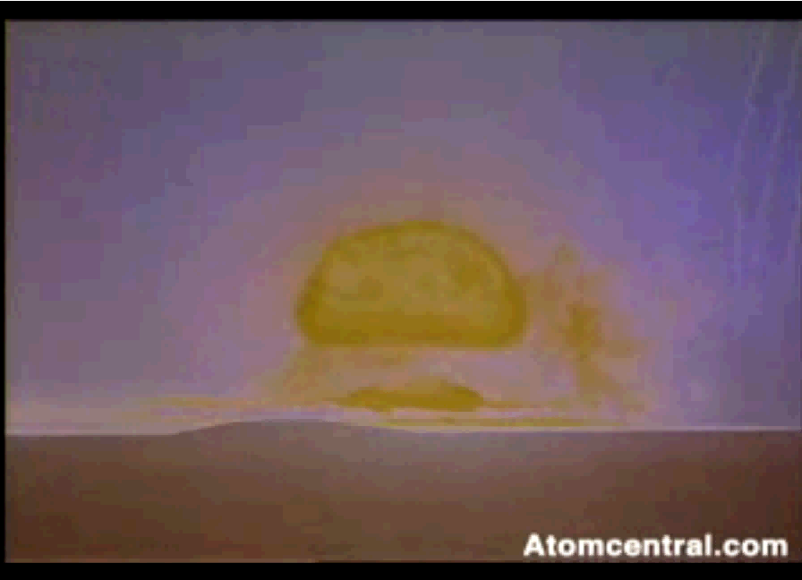

Slide 3
Agenda
The causes of the information explosion
The implications of this same information explosion
Some techniques to handle this information explosion
What is available in the marketplace to manage, protect, and archive information?
What’s coming in the future?

Slide 4
The causes of the information explosion
“The world’s total yearly production of print, film, optical, and magnetic content would require roughly 1.5 billion gigabytes of storage. This is the equivalent of 250 megabytes per person for each man, woman, and child on earth.”
  (Peter Lyman and Hal R. Varian, How Much Information, 2003;www2.sims.berkeley.edu/research/projects/ how-much-info/)
“By the time today’s kindergartners graduate from high school, the amount of knowledge in the world will have doubled four times. The Class of 2000 will be exposed to more information in one year than their grandparents encountered in their entire lives. They will have to assimilate more inventions and more information than have appeared in the last 150 years.”
  (Marvin Cetron and Owen Davies, American Renaissance, New York, St. Martin’s Press, 1989, p. 65)

Slide 5
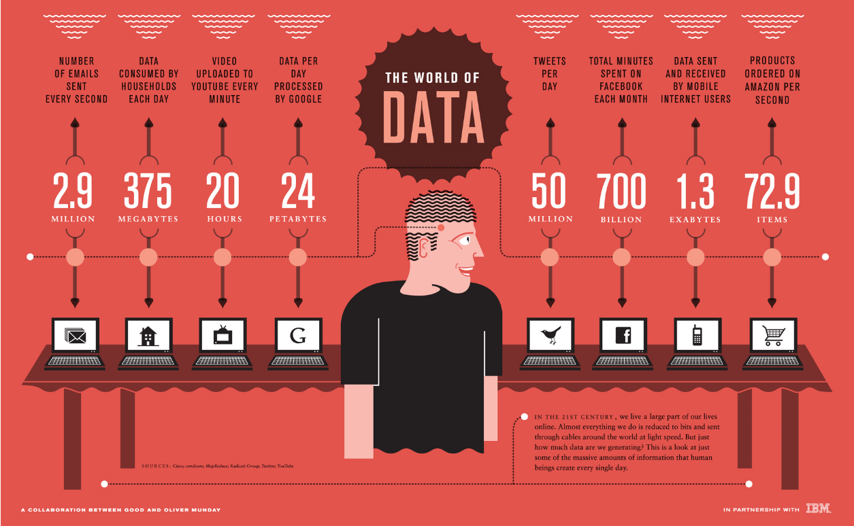
The causes of the information explosion

Slide 6
The causes of the information explosion
Number of Emails sent Every Second

Slide 7
The causes of the information explosion
Data Consumed by Households Each Day

Slide 8
The causes of the information explosion
Video Uploaded to YouTube Every Minute

Slide 9
The causes of the information explosion
Data Per Day Processed By Google

Slide 10
The causes of the information explosion
Tweets Per Day

Slide 11
The causes of the information explosion
Total Minutes Spent on Facebook Each Month

Slide 12
The causes of the information explosion
Data Sent and Received by Mobile Internet Users

Slide 13
The causes of the information explosion
Products Ordered on Amazon Per Second

Slide 14
The causes of the information explosion
Recent trends
  Gradual migration to electronic media
    E-books, E-pictures, Movies, Netflix,
  The massive increase in the number of PDAs (personal digital devices)
    Iphone, Ipad, Blackberry, laptops, etc.
  Greatly increased network bandwidths
  Greatly increase in the number of internet “cafes”
  The general migration from 1st class mail to email

Slide 15
The implications of this same information explosion
Average household produces 268 GB of data per year
The amount of data is growing.
  What do you do?
    Purchase more hard drives.
    Print out pictures
    Purchase more hard drives.
Leading Causes of Data Loss
  Hardware or System Malfunctions - 44% of all data loss
  Human Error - 32% of all data loss
  Software Corruption - 14 % of all data loss
  Computer Viruses – 7% of all data loss
  Natural Disasters – 3% of all data loss
  http://www.protect-data.com/information/statistics.html

Slide 16
The implications of this same information explosion
Laws are not keeping up with changes.
  Downloaded apps and data only as good as the equipment lasts.
  No standards for downloaded data
  Little or no standards for electronic media.
What happens when you lose data?
  Paper was the media of choice previously.
  Electronic media lasts only about 10 years
  Little or no automated way to detect media failure.

Slide 17
Some techniques to handle this information explosion
Do you back up?
  Have you backed up your computer lately?
    What media do you back up to?
Have you tested a restore?
What happens if you loose your operating system hard drive?
Can you do a Bare Machine Recovery?
Do you have a boot disk?
Have you tested the BMR recovery?
How long do you want to keep your data?

Slide 18
Some techniques to handle this information explosion
How long do they last?
  What kind of media do you use? (Backup media)
    Disk - current home disk failure rate is 3% to 7% per year
      Microsoft Research Technical Report MSR-TR-2005-166 December 2005
    USB – This depends greatly on the manufacturer. The external USB disk tend to fail at the same rate as home disk.
    CD/DVD – Failure rates are high upwards of 20% per disk per year. Under ideal environmental conditions, oxide starts to degrade between 5 and 15 years.
    Tape – The most reliable tape on the planet is guaranteed to last 15 years. (if you don’t use it and in a perfect environment)

Slide 19
Some techniques to handle this information explosion
Things to consider for data protection
What to look for in Data Backup Software?
  Feature Set
    Can the backup software protect you the way you wish?
  Ease of Use
    You should be able to install and use the software without help.
  Backup and Restore
    Backing up data should be simple and the restore should be easy
    Can you do Bare Metal recovery?
  Help Documentation

Slide 20
Some techniques to handle this information explosion
Things to consider for data protection
  Definitions
    Types of backup
      Full (file copy, image)
      Incremental
      Differential
      Mirror
      Snapshot
      Progressive Incremental

Slide 21
Some techniques to handle this information explosion
Types of backup (Definitions continued)
  Full (file copy, image)
    This is usually a complete copy of all data on a computer
  Incremental
    This process will only back up files that have changed since the last Incremental backup. This is usually used in conjunction with a full backup
  Differential
    This process will only back up files that have changed since the last full backup. This is usually used in conjunction with a full backup
  Mirror
    The disk is continuously synchronized with another disk
  Snapshot
    This is the same as a full.
  Progressive Incremental
    This technique uses background processes to move, compact, and optimize data within a certain set of media.

Slide 22
Some techniques to handle this information explosion
Things to consider for data protection
Individual File Backup
Files-in-Use Backup
Individual Folder Backup
Complete System Backup (Image Backup)
Backup Network Location
One-Click Drive Backup
Address Book Backup
Registry Backup
Backup Scheduling
Individual eMail Backup
Favorites Backup

Slide 23
Some techniques to handle this information explosion
Things to consider for data protection
Features
  Backup to Hard Drive
  Backup to Removable Media (CD,DVD,Zip, etc)
  Backup to FTP Locations
  Backup to Tape
  Backup to Online Server
  Backup Password Protection
  Backup Password Encryption
  Data Compression
  File Filtering
Features
  Backup Verification
  Drive Spanning
  Virus Scanning
  Backup Scripting
  Pre and Post Run Commands
  Event Logs/Reports/Catalog Backups
  Burning Software Included
  CD/DVD Erase Capability
  Create Bootable Backup

Slide 24
Some techniques to handle this information explosion
Some techniques to handle this information explosion
Things to consider for data protection
Restore Features
  Restore File Paths
  Restore Individual Files/Folders
  Restore Hard Drive Images
  Restore to a Separate Location
  Replaces Older Files and Duplicates

Slide 25
Some techniques to handle this information explosion
Some techniques to handle this information explosion
Things to consider for data protection
Technical Support
  Ease of use
  Knowledgebase/FAQ
  Support Ticket System
  Tutorials
  Live Chat Support
  Email/Contact Form
  Telephone Support

Slide 26
Some techniques to handle this information explosion
Some techniques to handle this information explosion
Things to consider for data protection
Supported platforms
  Windows
  Linux
  Apple
  Other
Hardware support
  Does the backup software support all the hardware you have?

Slide 27
What is available in the marketplace to manage, protect, and archive information?
Questions needed to be asked?
  "If my PC was stolen tomorrow what data would I really miss?“
What happens a disaster hits?
  Theft, fire, earthquake, etc.
Am I protected from virus attacks?
How important is having a computer available versus my data

Slide 28
What is available in the marketplace to manage, protect, and archive information?
What steps are taken to recover from hard disk crash?
  Obtain a new hard drive (easy)
  Hard Drive
    OS hard drive
      Recover the Operating System
      Reconfigure all devices and network
      Reinstall all applications
      Recover data
    Data hard drive (easy)
      Reinstall applications
      Recover data

Slide 29
What is available in the marketplace to manage, protect, and archive information?
What steps are taken to recover from hard disk crash?
  A lot of backup software are not designed to recover Operating System
  Recover from an image backup
    Pros
      Easy to use
    Cons
      Not tolerant of dissimilar hardware
      Need to have experience users

Slide 30
What is available in the marketplace to manage, protect, and archive information?
What do you need in a backup software?
  What do you want to protect?
  What Operating System do you have?
  What media do you wish to use?
    Removable Media
      CD, DVD, ZIP, Tape
    Fixed Media
How much total data do I have to back up?
  How long would my normal backup run.

Slide 31
What is available in the marketplace to manage, protect, and archive information?
Options available for Backup and Recovery
  Personal backup software
  Cloud backup software
Personal Backup Software
  License
  OS supported
  GUI
  Web

Slide 32
Backup Software: Free Software
Package | License | Available for Windows? | Available for Mac OS X? | Available for Linux? | Has a Graphical user interface? | Has a Web interface? | Has a Webmin module?
AMANDA | BSD | Yes | Yes | Yes | No | ? | Yes (separate download)
Areca Backup | GPL v2.0 | Yes | Yes | Yes | Yes | ? | No
Attix5 Online Backup | GPL v2.0 | Yes | Yes | Yes | Yes | Yes | Yes
BackupPC | GPL v2.0 | Yes | Yes | Yes | Yes | Yes | No
Bacula | GPL v2.0 | Yes | Yes | Yes | Yes | Yes | Yes
cpio | GNU | Yes(with Gnuwin32) | No | Yes | No | ? | Yes (separate download)
Create Synchronicity | GPL v3.0 | Yes | No | No | Yes | No | No
Cobian Backup | MPL | Yes | No | No | Yes | No | ?
DirSync Pro | GPL | Yes | Yes | Yes | Yes | ? | No
DAR | GNU GPL 3 | Yes | Yes | Yes | No | ? | ?
dd | GNU | Yes | Yes | Yes | No | No | No
dump | GNU | No | No | Yes | No | ? | ?
duplicity | GPL | Yes (with Cygwin) | Yes | Yes | No | ? | No
FlyBack | GPL | No | No | Yes | Yes | ? | No
luckyBackup | GNU GPL 3 | No | No | Yes | Yes | No | No
Mondo | GPL | No | No | Yes | Yes | ? | No
rdiff-backup | GPL | Yes | Yes | Yes | Yes | Yes | Yes
rsync | GPL | Partial[1] | Yes | Yes | No | ? | Yes (2 (separate downloads))
tar | GPL | Yes(with Gnuwin32) | Yes | Yes | Yes(GUI_Tar and Tar GUI [1]) | ? | ?
Zmanda Recovery Manager | GPL | Yes | No | Yes | No | ? | No

Slide 33
Backup Software: Proprietary Software
Package | Publisher | Available for Windows? | Available for Mac OS X? | Available for Linux? | Has a Graphical user interface?
.Mac Backup | Apple Inc. | No | Yes | No
Acronis True Image | Acronis | Yes | No | Yes | Yes
AIMstor Backup | Cofio Software | Yes | No | Yes | Yes
BackupChain | FastNeuron Inc. | Yes | No | No | Yes
ARCserve Backup | CA, Inc. | Yes | Yes | Yes | Yes
Aggregate Backup And Recovery System | IBM
Backup Express (BEX™) | Syncsort | Yes | Yes | Yes | Yes
Backup4all | Softland | Yes | No | No | Yes
BackupAssist | Cortex IT Labs | Yes | No | No | Yes
CDP Server | R1Soft | Yes | No | Yes | Yes
Copiun | Copiun | Yes | No | No | Yes
Crashplan | Code 42 Software, Inc. | Yes | Yes | Yes | Yes
Disco | Austin Sarner, Jasper Hauser and Jason Harris | No | Yes | No
Dmailer Backup | Dmailer | Yes | Yes | No | Yes
Druva InSync | Druva Software | Yes | Yes | Yes | Yes
EMC Legato NetWorker | EMC Corporation | Yes | Yes | Yes | Yes
Retrospect | Roxio | Yes | Yes | Yes (client only) | Yes
Genie Backup Manager | Genie-Soft | Yes | No | Yes | Yes
GRBackPro | GRSoftware | Yes | No | No | Yes
Handy Backup | Novosoft LLC | Yes | No | No
HP Data Protector | HP Software & Solutions | Yes | No | Yes | Yes
IBM Tivoli Storage Manager | IBM | Yes | Yes | Yes | Yes
IBM Tivoli Storage Manager FastBack | IBM | Yes | No | Yes | Yes
IBM Aggregate Backup And Recovery System | IBM
InMage DR-Scout | InMage
Image for Windows | TeraByte Unlimited | Yes | No | Yes | Yes
Langmeier Backup | Langmeier Software
Macrium Reflect | Paramount Software UK Ltd | Yes | No | No
Mozy | Mozy | Yes | Yes | No | Yes
System Center Data Protection Manager | Microsoft | Yes | No | No
NTBackup | Microsoft | Yes | No | No
Replay 4 | AppAssure Software | Yes | No | No | Yes
SOS Backup | SOS Backup | Yes |  |  | Yes
ShadowProtect | StorageCraft | Yes | No | No | Yes
SyncBack | 2BrightSparks | Yes | No | No | Yes
SyncToy | Microsoft | Yes | No | No | Yes
TotalRecovery | FarStone Technology | Yes | No | No | Yes
Backup Exec | Symantec | Yes | Yes | Yes | Yes
NetBackup | Symantec | Yes | No | Yes
Norton 360 | Symantec | Yes | No | Yes
Norton Ghost | Symantec | Yes | No | Yes
R-Drive Image | R-Tools Technology | Yes | No | No | Yes
Time Machine | Apple Inc. | No | Yes | No | Yes
Tonido Backup | CodeLathe | Yes | Yes | Yes | Yes
UltraBac | UltraBac Software | Yes | No | No | Yes
Unitrends | Unitrends | Yes | Yes | Yes | Yes
Uranium Backup | Freesoft Srl | Yes | No | No | Yes
Ventis BackupSuite 2008 | VentisPro ApS
Windows Home Server Computer Backup | Microsoft | Yes | Yes[2] | No
Windows Backup and Restore Center | Microsoft | Yes | No | No
Windows Live OneCare | Microsoft | Yes | No | No
Yosemite Server Backup | Barracuda Networks | Yes | No | Yes | Yes

Slide 34
Backup Software: Cloud Computing
Provider
Operating System Supported
Encryption
Capacity plans
Bandwidth limitations
Net Drive (Protocol supported)
P2P – Data spread over many computers
Sync – synchronization between computer and PDA
Public internet file hosting
Restore via physical media
Server locations
Maximum per-file size

Slide 35
What is coming in the Future?
Backup world is changing
  Business world backup features comes to the home
Bandwidth continues to expand
Token computing
  All data resides in the cloud
  Secured by tokens
  Deletion by individual policy
  Token reporting

Slide 36
Summary
Data continues to explode
  More and more information moving to electronic media
The individual has to be aware of the consequences of the growth of data
What can you do now to protect yourself?
  Backup your data
  Categorize you data to keep what you can’t replace in case of disaster.
This information is good for about 3 years

