Slide 1
Signal Processing and Early
Stage Venture Capital
Steve Goldberg
Partner, Venrock
July 9, 2014

Slide 2
Agenda
Historical Perspective: VC and Science
Current State of Affairs
Encouraging Sectors/Markets
Tips for the Future
Questions

Slide 3
Venture Capital and Science
Long run up during 80’s and 90’s, before the Internet, where technology infrastructure was being designed and built; networking, cellular, optics, telecom
Significant government funding from NSF, NIH, DOD, DOE, etc. during same period; fostered science-based development
Value creation turned to software-based, market-based risk companies after the Internet bubble
On science oriented projects, “If you build it, will they come?” became the concern of the day after the Internet bubble burst in 2000
Post 2000, Limited Partners to VC funds (LP’s) saw quicker liquidity and larger returns with “tech-lite” consumer software and low CAPEX companies

Slide 4
Current State of Affairs
Actually, quite a good market for entrepreneurs!
Respectable IPO activity
Lots of money (somewhat due to Fed stance, low inflation, and low interest rates)
Significant M&A activity; lots of cash in the hands of acquiring companies
Lots of new strategic VC’s

Slide 5
Current State of Affairs (con’t)
Many traditional markets have reached maturity (consolidation, low margins, low growth); e.g. semiconductors, cellular infrastructure, hardware-based networking, low-tech manufacturing
Some sector rotation into a number of traditionally, non-VC markets; e.g. space, robots, UAV’s, speech recognition, vision, high-tech manufacturing
High quality (early-stage) companies…..lots of them!
Venture activity heavily focused on solutions, not components

Slide 6
Encouraging Technology (Markets)
……at least for us science folks!
Including……
Robotics (manufacturing)
Big Data (marketing)
Internet of Things (control)
Wireless (communications)
Medical Devices (healthcare)
Self Driving Cars (transportation)
Satellites (imaging, com’s, weather)
UAV’s (imaging, com’s, delivery)
Image Recognition (advertising, control)
Augmented Reality (marketing, education)
remember…..don’t confuse technology with markets

Slide 7
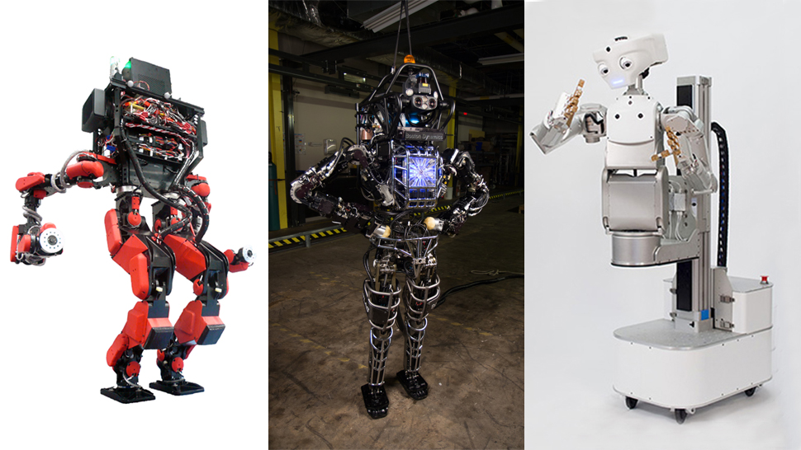
Robotics

Slide 8

Robotics (con’t)

Slide 9
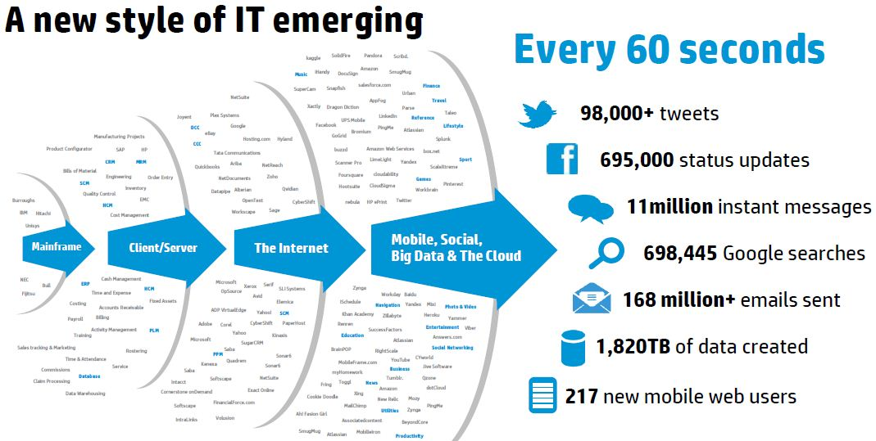
Big Data

Slide 10
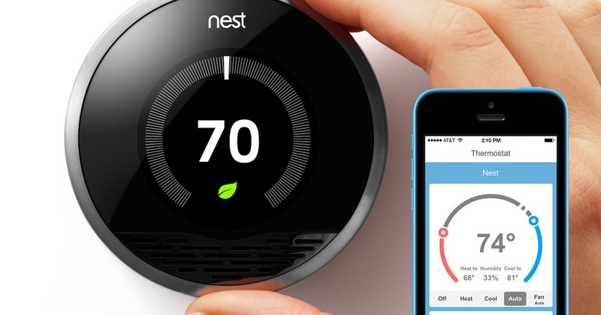
Internet of Things

Slide 11
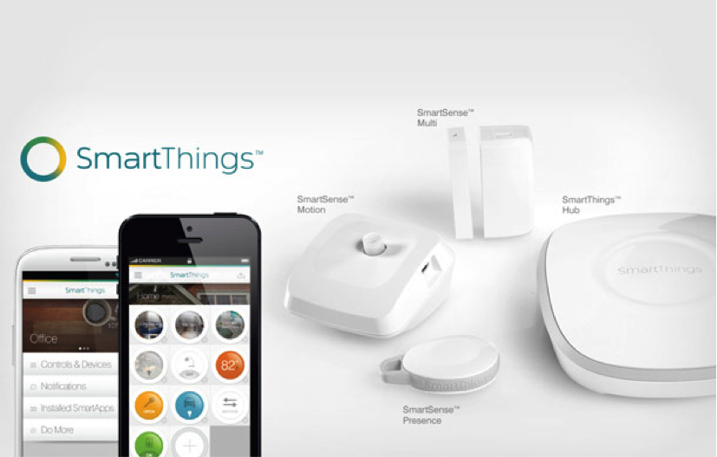
Internet of Things (con’t)

Slide 12
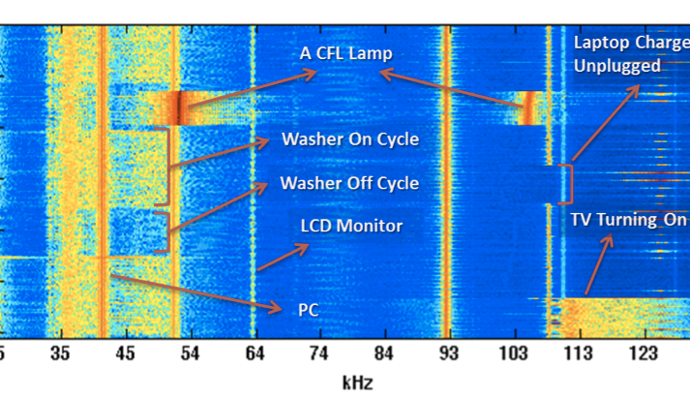
Internet of Things (con’t)

Slide 13
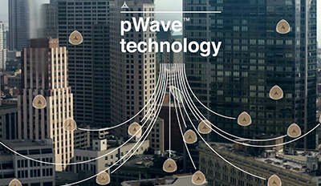
Wireless

Slide 14
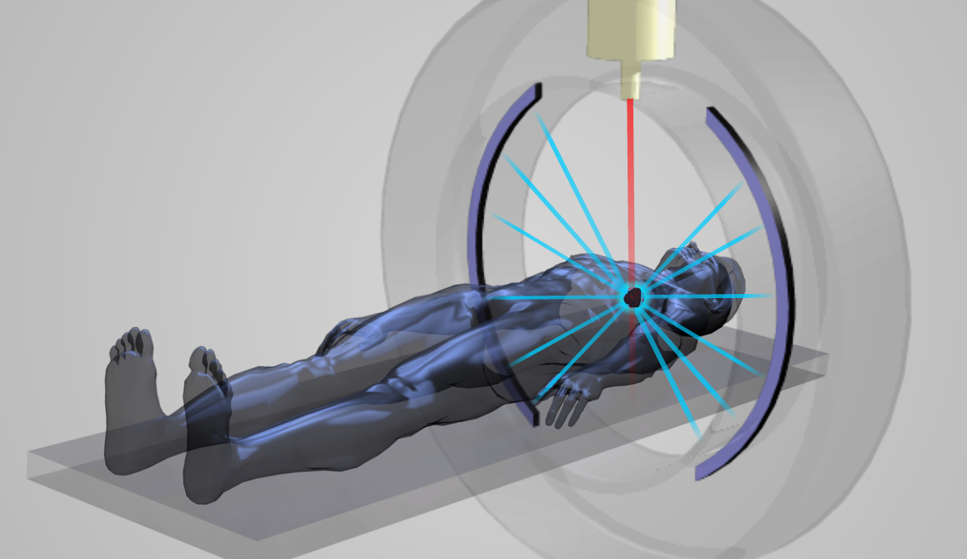
Medical Devices

Slide 15
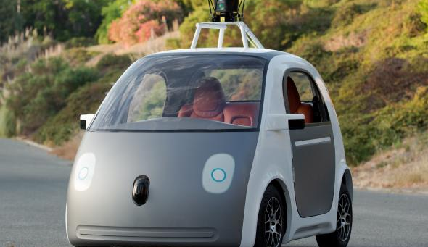
Self Driving Cars

Slide 16
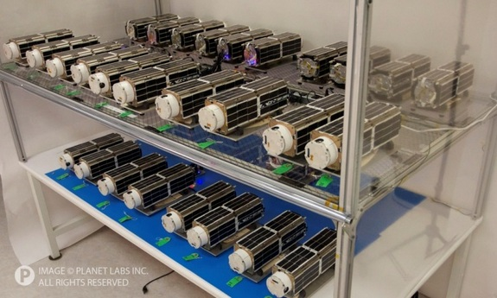
Satellites

Slide 17
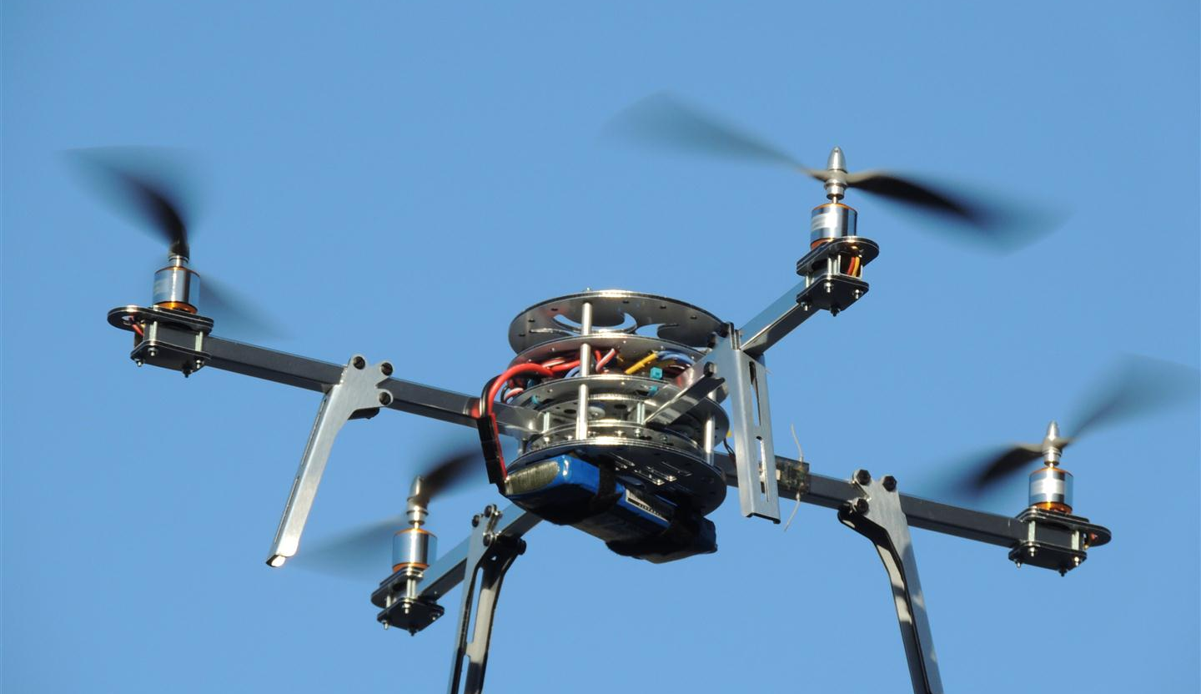
UAV’s

Slide 18
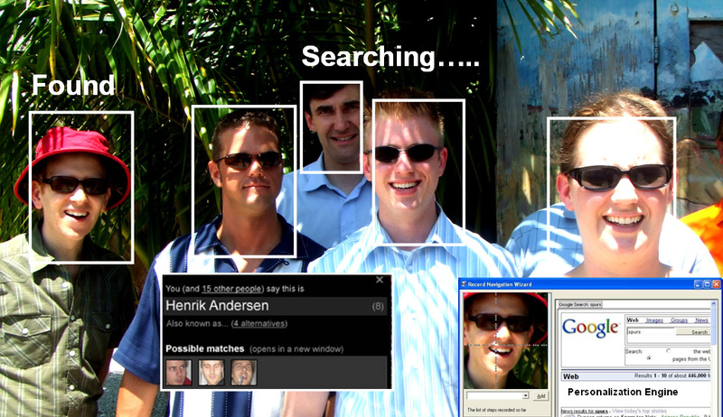
Facial Recognition

Slide 19
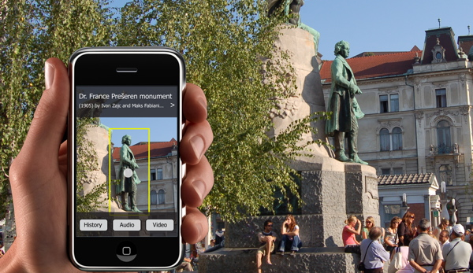
Image Search

Slide 20
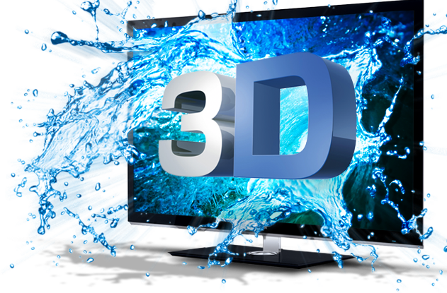
Video

Slide 21
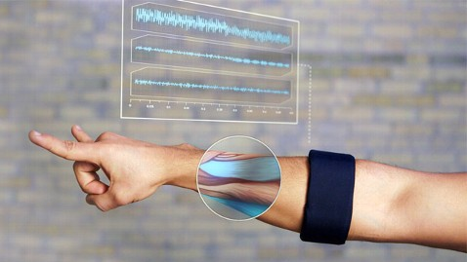
Position Sensing

Slide 22
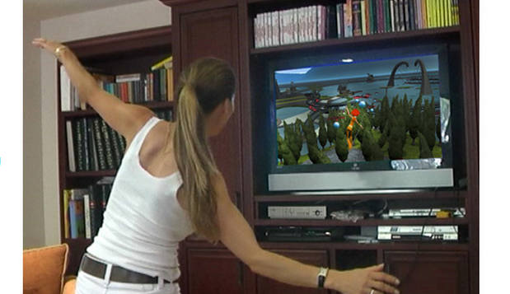
Gesture Technology

Slide 23
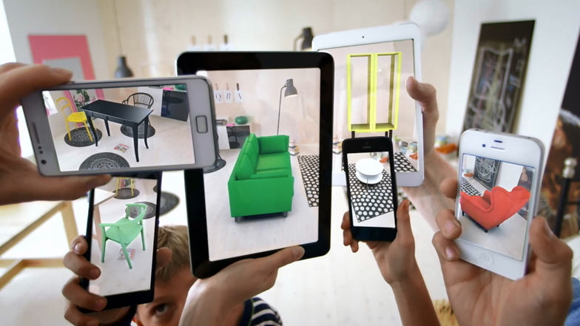
Augmented Reality

Slide 24
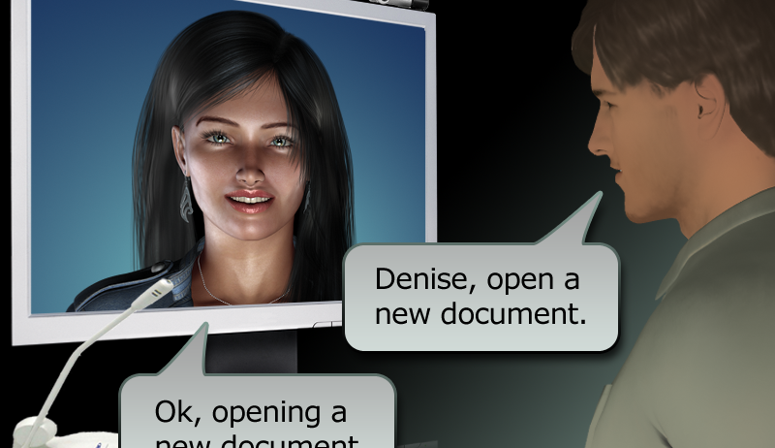
Human Speech Recognition

Slide 25
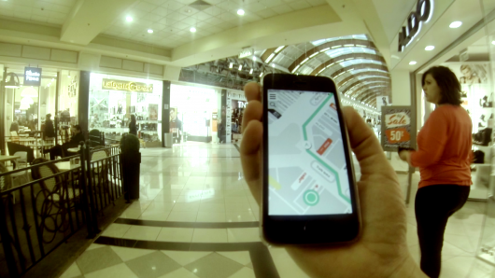
Precise Positioning

Slide 26
Tips for the Future
Of course…follow your passion…but…keep the following in mind….
Investors follow the money…..
Many markets are cyclical…be patient
Look for enabling technology that was not possible a year ago….
Look for achievable “entry points” into complex markets/products
Venture activity heavily focused on solutions, not components

Slide 27
Questions/Contact Info
steve@venrock.com

