Slide 1
Toshio FUKUDA, IEEE Life Fellow Candidate for 2019 IEEE President-Elect t.fukuda@ieee.org tofukuda@nifty.com <http://www.mein.nagoya-u.ac.jp/personal/fukuda>

Slide 2
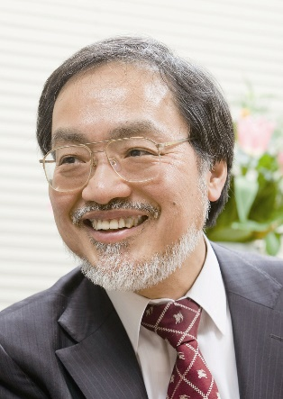
Who am I?
Background: Born/ raised in Toyama, Japan
ME@ Waseda, Tokyo, MS@Yale, New Haven, D.Sc.@University of Tokyo, Tokyo, JAPAN
Post Doc@Univ. Stuttgart, Germany
Research Scientist@National Mechanical Engineering, Tsukuba, Japan
Professor @Science University of Tokyo, Nagoya University, Meijo University, Japan, Beijing Institute of Technology, China
Interests: Intelligent Robotics, Micro and Nano Robotics
Academics+ind. broad exposure: Toyota, Honda, Canon, Mitsubishi, Yanmar, etc.
Career recognitions: IEEE LF, Japan Council of Science, Academy of Engineering Japan, Foreign Member of Chinese Academy of Science
IEEE: President RAS, Founding President NTC, EiC Trans. Mechatronics, Founding Chair IROS, Nanotechnology, ARSO, SII, CBS, ISR, IEEE Boards (Director(2001-02, 2017-18, Division X and Region 10(2013-14)), PSPB, Standard, Award committee for Medal on Environment and Safety Technology

Slide 3
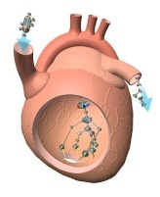
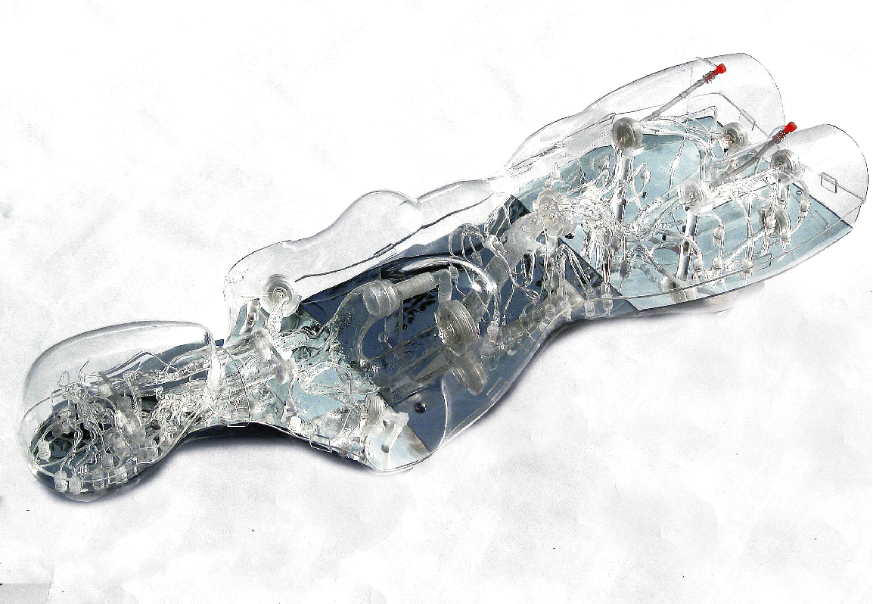
Nagoya University
Micro-Nano Systems Department
Fukuda Laboratory
Industry Commercialization: EVE
Challenging the Frontier of the Surgical Simulation since 1989
FAIN-Biomedical Inc. founded in 2005

Slide 4
What I Want to Do in IEEE
Improve Financial Transparency,
Revise Membership Fee
Join at least one Technical Society,
Introduce Corporate Membership for Industry, and
Create IEEE-University making use of the MOOC.

Slide 5
What Vision and Aspiration for IEEE
Membership: stuck at 420K, S/C at 300K, possibly decreasing
Globalization, membership increase, what does it take to double or reach the 1M mark?
Understand value proposition to different segments: YPs, diverse gender and regions and countries, professional interests
Go beyond academics journals and conf. to new type events (YP, WiE , Entrepreneur), professional growth, education (students), career progression, industry/practitioner segments
New revenue structure and businesses model that appeal to members and community at large
Healthy Balance of IEEE Operation Budget:, financial transparency, increase net revenue to member activities

Slide 6
Home, Value and Connection in IEEE
BOD
SA
8%
2-4 %
77-78 %
14%
TAB
PSPB
MGA
EAB
Opportunities
Financial Flow
IEEE Due
1
Member
?
2
Non Member
Entrepreneur
Industry
Academia
Student
WIE
YP

Slide 7
Possible Strategy
IEEE Due Fee : US$165 too expensive. Need to reduce the entry fee: Zero, US$10, US$30, US$72, US$98, but not more than US$100.
TAB societies membership: 75% ( with overlapping)
IEEE: Technology innovation driven organization
No entry point of the access from MGA to Non-member
TAB societies and councils have the access to the non-members through IEEE conferences and publications.
Make use of the entry point as opportunity to IEEE to TAB meetings/conferences and publications to MGA.
Introduce Corporate membership for Industry.

Slide 8
What Type of Leader
As Director, both TAB and MGA oversighting Activities:
Joint MGA-TAB on membership looking at value proposition and types of membership to expand, retain, attract new members, Industry Promotion
TAB-PSPB: Find new fields and leverage technology for publication and R&D
Joint TAB-Standards: IEEE Leadership in social implications of technology
Revenue/financial Structure updates and changes
Make best practice from staffs to members, and vice versa.
Listen, identify problems and focus organization in solution
Team player and doer
Good role model for Globalization
Thank you for listening.
<http://www.mein.nagoya-u.ac.jp/personal/fukuda>

