Slide 1
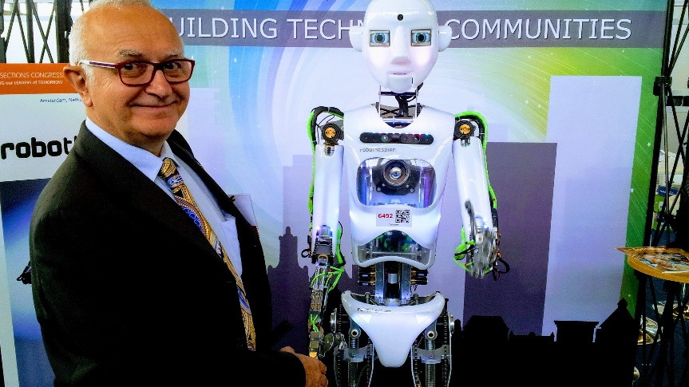
Jacek Zurada IEEE Life Fellow
Candidate for 2019 IEEE President-Elect
Presentation to IEEE R3 Volunteers
Tampa, FL, April 20, 2018

Slide 2
Membership, Membership, Membership
TA
MGA
Better Retain/Recruit/ Serve Members
Industrial
Students/YPs
Global
Redefine Value Proposition
Relevance to jobs, careers
Satisfy members’ information needs
Improve Synergy of TA and MGA
Bring Sections and S/Cs closer
Bridge gaps between Boards

Slide 3
Personalization, Personalization, Personalization
Access to
Person-alized Info
S/C Resource Centers
Industry/ Corporate Info Portals

Slide 4
Outward and Inward Look
Lead in Innovative Technologies
AI/Cloud/Computing/Communications
Seamless Intelligence
Exercise Public Voice
Governments and global business
Public discourse, image of the profession
Business-critical vs. other deliberations/decisions
Accounting: product lines, corporate expenses, investing
Strive for Transparency and Clarity

Slide 5
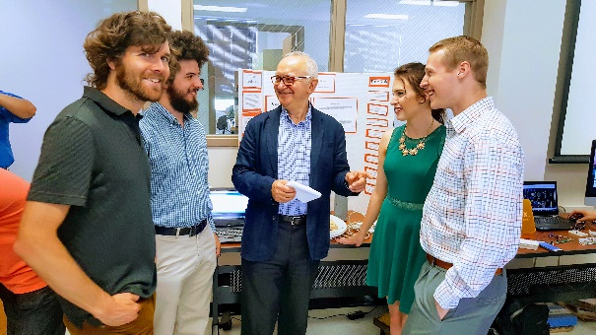
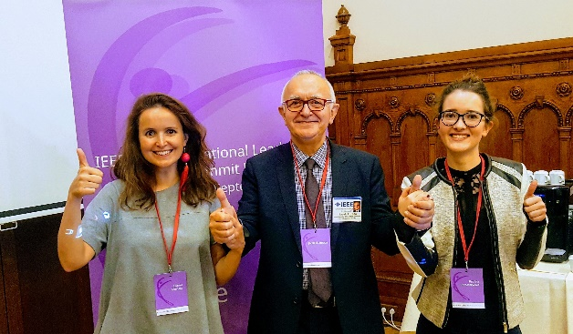
Expertise and Accomplishments
Professional Career
Academic: neural networks, pub-s with 11.6k citations
International: Poland, Switzerland, KY 30+ years, Asia
IEEE Service
TAB Chair, Periodicals, PRAC, Society President, EIC
PSPB V-Chair, TAB Rep to MGA
IEEE Accomplishments
Pioneered the marketing of educational modules
Globalization Initiative, Fin-trans, 12 new Magazines

Slide 6
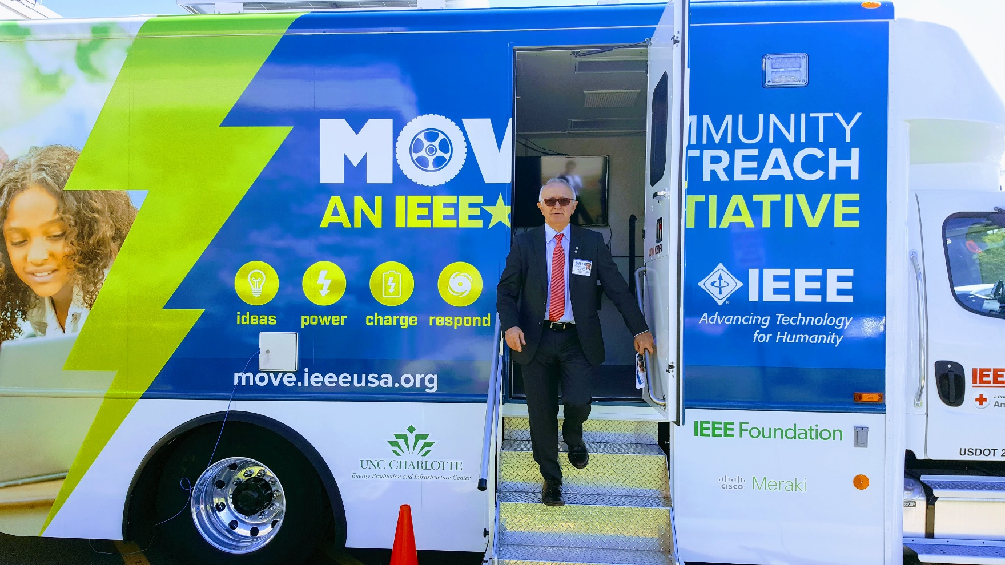
Loyalty: As a resident of R3 since 1981, I pledge to MOVE

Slide 7
Title and Content Layout with Chart
3C=Communities+Content+Career

