Slide 1
Engaging Members through Sustainable Development and Humanitarian Technology Programs
Mary Ellen Randall
IEEE Humanitarian Activities Committee

Slide 2
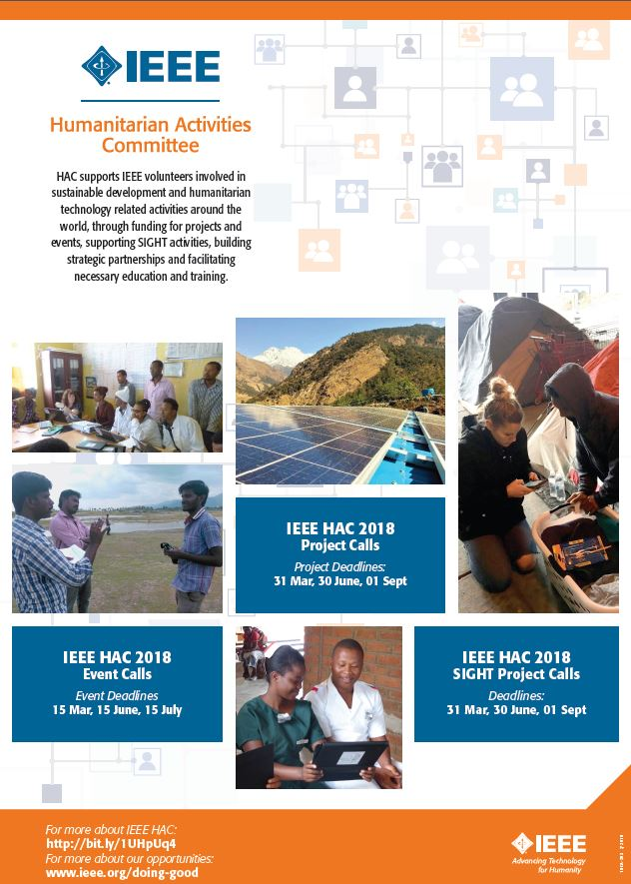
Mission
The IEEE Humanitarian Activities Committee supports the IEEE Board-endorsed vision of IEEE volunteers around the world carrying out and/or supporting impactful humanitarian activities at local level.
HAC supports Sustainable Development related IEEE volunteer activities by
Providing financial support to relevant projects and events
Providing educational, mentoring and networking support
Promoting and supporting collaboration by IEEE & non-IEEE volunteers through IEEE SIGHT (Special Interest Group on Humanitarian Technology) Program
Building strategic partnerships with other relevant stakeholders
Providing volunteers who support local teams undertaking “feet-on-the ground” community based activities

Slide 3
HAC Subcommittees
Projects
SIGHT
Assessment
Executive Committee
Communications
Education
Events
Partnerships

Slide 4
HAC Supports
Awareness Raising of Humanitarian Activities
Engagement with Humanitarian
Projects and Events
Contribution to the Sustainable Development* Community
Training, Networking and Mentoring
*How the “humanitarian” space is often defined outside IEEE.

Slide 5
UN Sustainable Development Goals (SDG)

Slide 6
Projects
SUPPORTING
Experienced teams with a strong track record
Proposals demonstrating clear understanding of target community needs, alignment with SDGs and volunteer “feet-on-the ground” activities strengthening local capacity through technology adaptation and deployment
Grants of US$20k - $60k per funded project (max. 12 month duration)
2018 Call for Proposal Deadlines:
31 March
30 June
01 September
Contact: hac-projects@ieee.org

Slide 7
Project Support
Attributes
Supporting local IEEE volunteers to address community challenges – “feet-on-the-ground” projects
Clearly articulate local community needs, how they are involved and will benefit
IEEE Volunteers responsible for implementing project are living in target country/countries
Address local capacity building, technology adaptation and deployment, assessment, impact and sustainability
Direct project costs (equipment, materials, supplies, necessary travel) for 12 month period
Please note there is no reimbursement of volunteer salaries or indirect costs (overhead, F&A, project management, administration)
Projects NOT considered for support
Do not clearly articulate active community involvement, address local needs or sustainability plan
Projects focused primarily on
Research
Immediate disaster relief
Development of technology for arbitrary development (e.g. building better water pump for resource constrained environments)
Supplying or distributing existing products
Commercial implementation or deployment

Slide 8
Event Support
SUPPORTING
Humanitarian activities within existing events
Support for showcasing sustainable development and humanitarian technology activities within existing events – e.g., sessions, tracks, workshops, speakers
Support developing sessions, identifying speakers, publicity
Partial grant funding of up to US$15k towards specific activities
2018 Call for Proposal deadlines
15 March
15 May
15 July
Contact: hac-events@ieee.org

Slide 9
Event Support
Attributes
Supporting Humanitarian and Sustainable Development elements within existing events
Pre-conference workshops, Tracks, Workshops, Plenary Speaker, Panel Sessions
Clearly articulate
how the component(s) requesting support is aligned with HAC vision
Supports capacity building or showcases IEEE volunteers undertaking sustainable development activities
Target audience
Proposed performance metrics
Please note that IEEE events must have official conference approval prior to submitting request for support. All applications must include confirmation of approval for this request from General Chair, Program Chair or local Section Chair.
Elements of events NOT considered for support
Sponsorship of entire conference
IEEE Distinguished Lecturer Series
Regular IEEE Organisational Unit meetings (including section, chapter, committee meetings)
Scholarship to individuals
Participation of individual(s)/team(s) at competitions or awards
Cannot support projects or provide seed funding for start ups

Slide 10
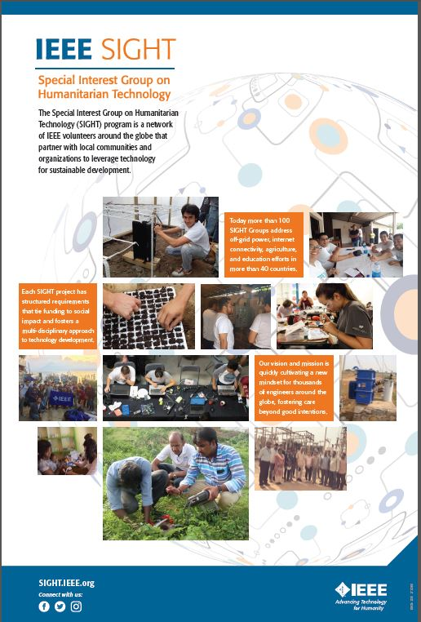
IEEE SIGHT
A network of IEEE and non-IEEE volunteers around the globe that partner with local communities to leverage technology for sustainable development
sight.ieee.org

Slide 11
SIGHT Program
SIGHT is a global network of IEEE and non-IEEE volunteers working in partnership with local communities to leverage technology for sustainable development
SIGHT projects have structured requirements tying funding to social impact, fostering a multi-disciplinary approach to adaptation and deployment of technology
SIGHT provides education, training, mentoring and other resources to support effective, ethical collaboration between IEEE and non-IEEE volunteers with complimentary skills and experience
SIGHT groups in over 40 countries address local societal challenges in fields including agriculture, education, health, connectivity and off-grid power
sight.ieee.org

Slide 12
SIGHT Project Support
SUPPORTING
SIGHT Groups located in target country/countries
Proposals demonstrating consultation with and a clear understanding of the needs of target communities as well as active local stakeholder involvement in “feet on the ground” activities leveraging appropriate use of technology
Grants of US$1,000 - $19,999 per funded project (max. 12 month duration)
2018 Call for Proposal deadlines:
31 March
30 June
01 September
Contact: hac-projects@ieee.org

Slide 13
SIGHT Project Support
Attributes
Supporting SIGHTs to address community challenges – “feet-on-the-ground” projects
Clearly articulate consultation with local communities, needs driven approach, how they are involved and will benefit
Aligned with UN Sustainable Development Goals
IEEE Volunteers responsible for implementing SIGHT project are living in target country
Address local capacity building, technology adaptation and deployment, assessment, impact and sustainability
Direct project costs (equipment, materials, supplies, necessary travel) for 12 month period
Please note there is no reimbursement of volunteer salaries or indirect costs (overhead, F&A, project management, administration)
Projects NOT considered for support
Do not clearly articulate active community involvement, addressing local needs or sustainability plan
Projects focused primarily on
Research
Immediate disaster relief
Development of technology for arbitrary development (e.g. building better water pump for developing world)
Supplying or distributing existing products
Commercial implementation or deployment

Slide 14
Where are IEEE SIGHT Groups?
Have an idea for France?
Will you start a project in Brazil?
Will you start the South Africa Section SIGHT?

Slide 15
For more information
R3
Mary Ellen Randall, R3 HAC Chair, merandall@ieee.org
Volunteer Lead
Paul M Cunningham, HAC Chair, pcunningham@ieee.org
Staff Lead
Holly Schneider Brown, h.s.brown@ieee.org
Access IEEE HAC, IEEE SIGHT and other IEEE H&P Opportunities
www.ieee.org/doing-good

