Slide 1
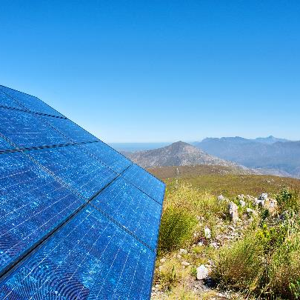
IEEE Standards Association
r2
Bruce Kraemer
Past President, IEEE Standards Association
April 2018
Notes:
Let’s begin with some historical information on standards.
Other than speech and writing How far back in human history do technical standards go?
Lets look at a few examples.

Slide 2
Notes:
First we look back 5000 years

Slide 3
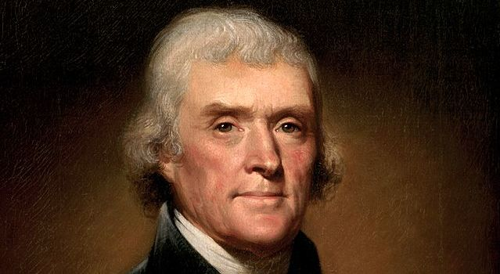
Jan 2, 1790 George Washington requests Congress develop a standards system
Jan 15, 1790 the task was assigned to Thomas Jefferson (Secretary of State)
Report submitted to Congress July 4, 1790, presented July 13, 1790
Notes:
Now step forward to the earliest days of the United States
Pictured here is Thomas Jefferson
Why?

Slide 4
Jefferson proposal July 13, 1790
Jeffersonian decimal proposal
Length
point | = 1/10 line
line | = 10 points
inch | = 10 lines
foot | 1 (11.744736 of today’s inches)
decad | = 10 foot
rood | = 10 decads
furlong | = 10 roods
mile | = 10 furlongs
Notes:
What did Jefferson propose.
In part this…

Slide 5
Early US Standards
Jefferson’s proposal extensively considered in Congress for years but not enacted
However, pressured by a need to measure land in the westward expansion…..
On May 18, 1796 Congress adopted Gunter’s chain standard of 22 yards.

Slide 6
Standards Updated
International System of Units (SI) (Système international d'unités)
Discussion began in parallel with Jefferson
finalized in 1960
Evolved to International System of Quantities (ISQ) ISO/IEC 80000, and was finalized in 2009 with the publication of ISO 80000-1.
SI Base quantity units Name Symbol
length meter m
mass kilogram kg
time second s
electric current ampere A
thermodynamic temperature kelvin K
amount of substance mole mol
luminous intensity candela cd
Notes:
At roughly the same time as Jefferson work began in France.
Almost 200 years later we note some progress.
Some of you might be engineers and recognize these terms.

Slide 7
Lessons Learned – Guiding Principles
Some standards take a long time to completion
You may have sufficient technical skill to write a standard on your own - don’t
Organized, focused, group collaboration brings a diversity of geographic needs, unique ideas and robust debate about the best solution
Each participant contributes to building market demand
Standards connected to urgent market demand get done and used.
Local or national standards are sometimes necessary but only an international standard creates global demand.
Standards have a finite lifetime and must be reconfirmed, updated or deleted.
Standards come from multiple sources ;sometimes collaborative sometimes competitive
A fair, well managed , repeatable process is vital to attracting and retaining contributors
One standard does not define an entire system, it will contain multiple standards.
Notes:
Of course there is a reason for dragging you through 5000 years of standards history.

Slide 8
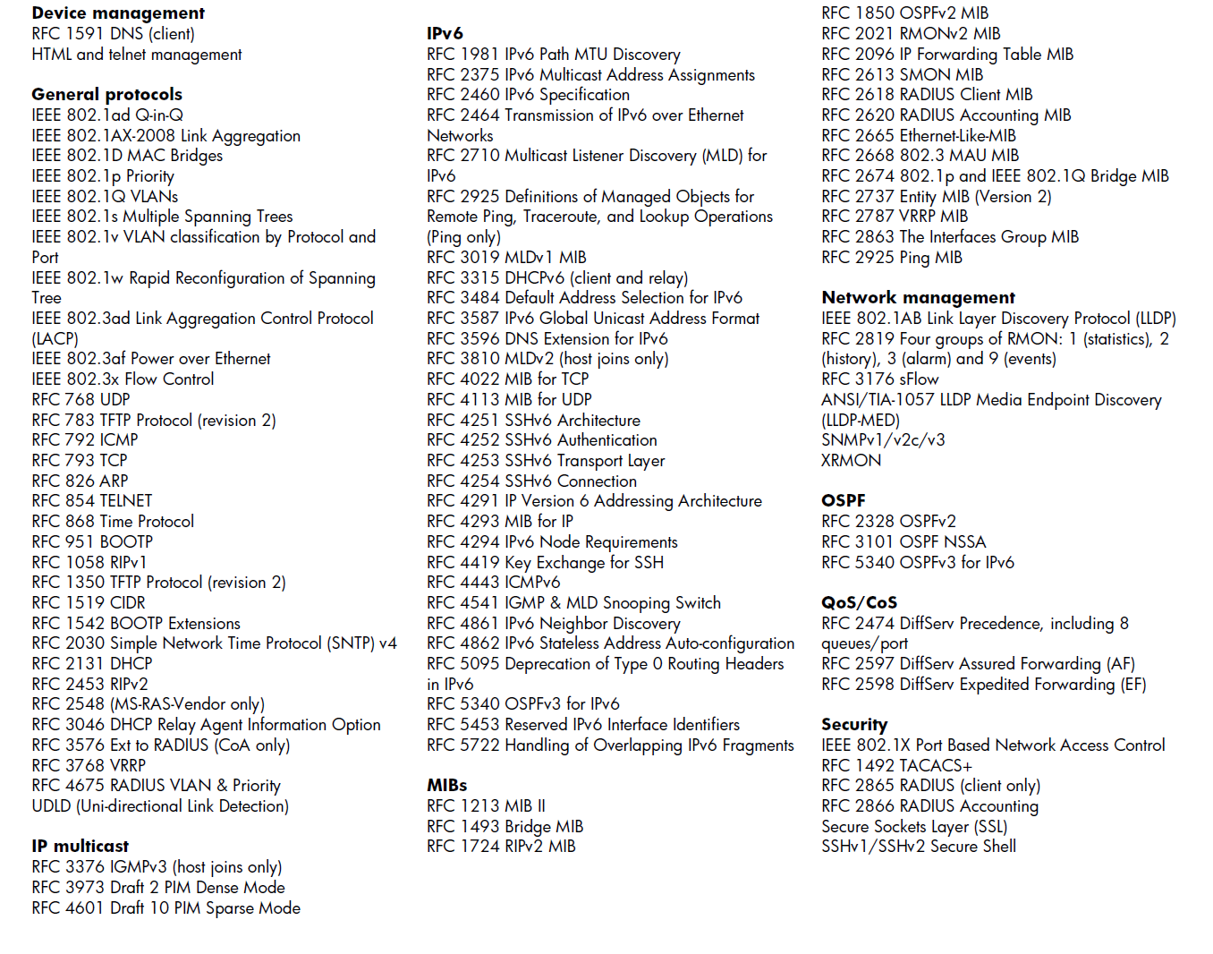
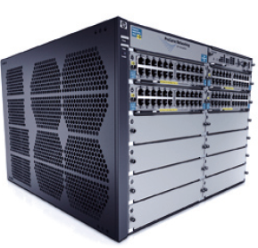
Standards, Products, Reality
100 Networking Standards!
HP E5400 zl Switch Series
See: http://h20195.www2.hp.com/v2/GetPDF.aspx/4AA2-6511ENW.pdf

Slide 9
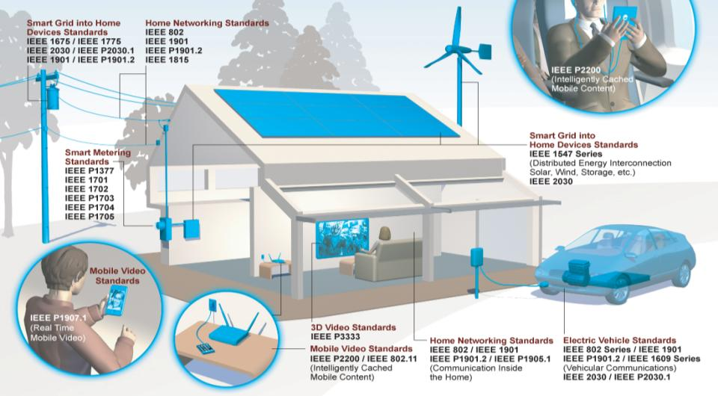
IEEE Standards in Real Life
Notes:
These are some examples of how IEEE Standards make the world safer and more connected.

Slide 10
How does IEEE translate and encapsulate all this vast wisdom?

Slide 11
IEEE Standards Association (IEEE-SA)
IEEE MEMBERS
Board of Directors (BOD)
Exec Director & Staff
Technical
Activities
Publication
Activities
Standards
Association
Member & Geographic Activities
Educational
Activities
IEEE-SA Board of Governors
(BOG)
Computer Society
Tech Sponsor
WG
WG
802
802.1
802.3
802.11
Communications Society
Tech Sponsor
Standards Board
(SASB)
Corporate Advisory Group
(CAG)
WG
Tech Sponsor
WG
WG
WG
Administrative Committee
(AdCom)
Audit Committee
(AudCom)
Industry Connections Committee
(IC Com)
New Standards Committee
(NesCom)
Patent Committee
(PatCom)
Procedures Committee
(ProCom)
Standards Review Committee
(RevCom)
11

Slide 12
IEEE Standards Association (IEEE-SA)
Mission
Enable and promote the collaborative application of technical knowledge to advance economic and social well-being through the development of technical standards and related activities
Vision
Be recognized as a preferred global provider of high-quality, market-relevant technology standards and of services that promote their universal adoption

Slide 13
IEEE SA Core Principles
Respectful cooperation between standards organizations
Adherence to the fundamental parameters of standards development (due process, consensus, transparency, balance, openness)
Collective empowerment to strive to develop standards that are chosen and defined based on technical merit
Availability of standards specifications
Voluntary adoption of the standards by the market

Slide 14
IEEE Standards Development Process
Identify Technical Committee(s) & Format
Consensus ballot
&
Public Review
Project approval
Develop draft standard
Standards Board approval
Editorial Review
SASB meets 4 times a year to approve new PARs submitted by technical sponsors.
Average time from PAR to SASB Approval is about 39 months
Amend & Revise standard
Publish Standard
Develop Certification Tests

Slide 15
IEEE Standards Development Options
Individual Method
Participants are individual technical experts
Each individual participant has 1 vote
Entity (Corporate) Method
Participants are “entities,” i.e., companies, universities, government bodies, etc.
Each entity has 1 vote
Requires 3 entities
Ballot groups are made up of a minimum of 10 individuals
Ballot group participants must be IEEE-SA individual members
Individuals represent themselves
Designated representative and alternate represent the entity
Entity sends representatives to meetings
Open membership, participation, and governance
No restrictions
Any individual or organization
Includes academia
Any industry or size of company

Slide 16
Technologies in IEEE Standards
Aerospace Electronics
Broadband Over Power Lines
Broadcast Technology
Clean Technology
Cognitive Radio
Design Automation
Electromagnetic Compatibility
Green Technology
Ethernet/Wi-Fi
Medical Device Communications
Nanotechnology
Organic Components
Portable Battery Technology
Power Electronics
Power & Energy
Radiation/Nuclear
Reliability
Transportation Technology

Slide 17
IEEE Standards Association (IEEE-SA)
1,250+ Active standards （139 approved in 2017)
650+ projects in progress (198 initiated in 2017)
7,150+ IEEE-SA Individual Members
215 IEEE-SA Entity Members (Corporations, Univ, Govt Agencies)
20,000+ participants in standards development

Slide 18
Global Collaboration
ISO/IEEE PSDO Agreement address adoptions and joint development work between the ISO and IEEE
Currently covers the following areas:
ISO TC 204 — Intelligent transportation
ISO TC 215 — Health Informatics
ISO/IEC JTC 1 — All subcommittees
IEC/IEEE Dual Logo Agreement was signed in 2002 to approve IEEE Standards are eligible for adoption by IEC
IEC/IEEE Joint Development Agreement was signed in 2008. It provides an IEEE Working Group and an IEC Maintenance Team the ability to develop one standard with IEC and IEEE logo
The IEEE is a Sector Member of
ITU-R (Radio Communication)
ITU-T (Standardization)
ITU-D (Development)
Example technical areas
Radio regulatory activities
Mobile broadband wireless access
Notes:
IEEE nurtures, develops, and advances the building of global technologies.
How?
As the world becomes more integrated, there is a growing need for standards to help that connectivity. Standards provide the bricks and mortar for a globally level playing field for innovation. IEEE has been committed to standards development for over a century, for we believe that innovation can—and should—come from anywhere.

Slide 19
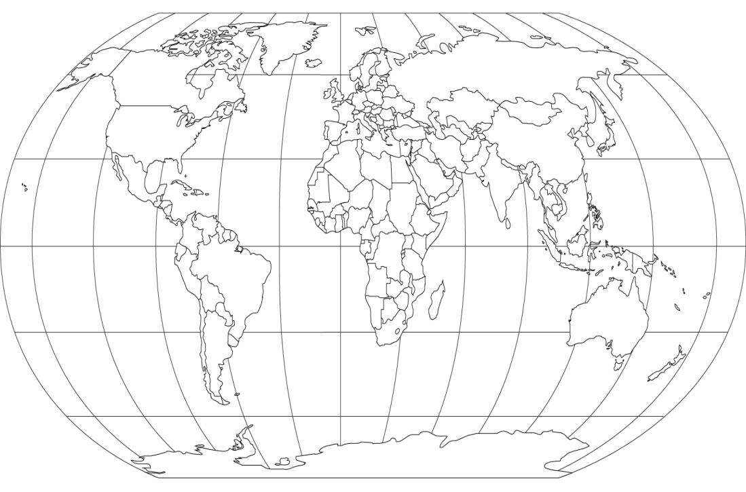
National Collaboration
China
Examples

Slide 20
IEEE Standards in the Market
IEEE 802.11
IEEE 1800
IEEE 802.3
Ethernet
IEEE 802.15.4
IEEE 1547
Distributed Resource
National Electrical Safety Code®

Slide 21
IEEE Standards Drive Markets (Individual Project)
3 million
Units
per day
IEEE 802.11 (Wireless LAN)
1,000
900
Market size & diversity continues to increase
800
700
Pads/Tablets
600
Enterprise APs
500
Home/SOHO
1 million
Units
per day
Devices (million units)
400
Consumer Electronics
Phones
300
PCs
200
100
0
2006
2010
2013
Source: In-Stat

Slide 22
IEEE Standards Drive Markets (Entity Project)
IEEE 1800TM: Standard for SystemVerilog--Unified Hardware Design, Specification, and Verification Language
Pre-IEEE
Accellera consortium created open standard for industry adoption
IEEE
IEEE used consensus process to achieve global approval
Created stable standard for industry to adopt
IEC
Used IEEE/IEC dual-logo process
Pre-IEEE Standardization
Post-IEEE Standardization
2003: Co-Design, Real Intent, Mentor, Synopsys, Intel & Infineon
2004: 6 companies with 9 products
2005: 45 companies with 91 products
2006: 109 companies with more than 280 products
2007: 137 companies with more than 350 products

Slide 23
Selected Emerging Tech Standards Projects Underway
IEEE P2413, Draft Standard for an Architectural Framework for the Internet of Things
IEEE P1873.1™ - Draft Standard for Robot Map Data Representation for Navigation
IEEE P11073-10101a™: ISO/IEEE 11073-10101:2004 - Health informatics - Point-of-care medical device communication - Nomenclature Amendment for additional definitions)
IEEE P1667™ - Standard for Discovery, Authentication, and Authorization in Host Attachments of Storage Devices
IEEE P1721™ - Standard for Objective Measurement of Systemic Arterial Blood Pressure in Humans
IEEE P1822™ - Standard for Digital Microscope Analyzer, Whole Slide Image Scanner and Digital Microscope
IEEE P1847™ - Recommended Practice for Common Framework of Location Services (LS) for Healthcare
IEEE P1859™ - Standard for Relaxor-Based Single Crystals for Transducer and Actuator Applications
IEEE P3333.1.2™ - Standard for the Perceptual Quality Assessment of Three Dimensional (3D) Contents based on Physiological Mechanisms
IEEE P3333.2.2™ - Standard for Three-Dimensional (3D) Medical Visualization
IEEE P3333.2.3™ - Standard for Three-Dimensional (3D) Medical Data Management
IEEE P3333.2.4™ - Standard for Three-Dimensional (3D) Medical Simulation
IEEE P1797 - Guide for Design and Application of Solar Technology in Commercial Power Generating Stations
More than 100 standards and standards in development relevant to smart grid, including the over 20 IEEE standards named in the NIST Framework and Roadmap for Smart Grid Interoperability Standards, Release 1.0.
P2301 (Cloud Profiles)
P2302 (Intercloud)

Slide 24
IEEE Ethics Initiative Standards Projects Underway
IEEE P7000™ - Model Process for Addressing Ethical Concerns During System Design
IEEE P7001™ - Transparency of Autonomous Systems
IEEE P7002™ - Data Privacy Process IEEE P7003™ - Algorithmic Bias Considerations
IEEE P7004™ - Standard on Child and Student Data Governance
IEEE P7005™ - Standard for Transparent Employer Data Governance
IEEE P7006™ - Standard for Personal Data Artificial Intelligence (AI) Agent
IEEE P7007™ - Ontological Standard for Ethically Driven Robotics and Automation Systems
IEEE P7008™ - Standard for Ethically Driven Nudging for Robotic, Intelligent, and Automation Systems
IEEE P7009™ - Standard for Fail-Safe Design of Autonomous and Semi-Autonomous Systems
IEEE P7010™ - Wellbeing Metrics Standard for Ethical Artificial Intelligence and Autonomous Systems

Slide 25
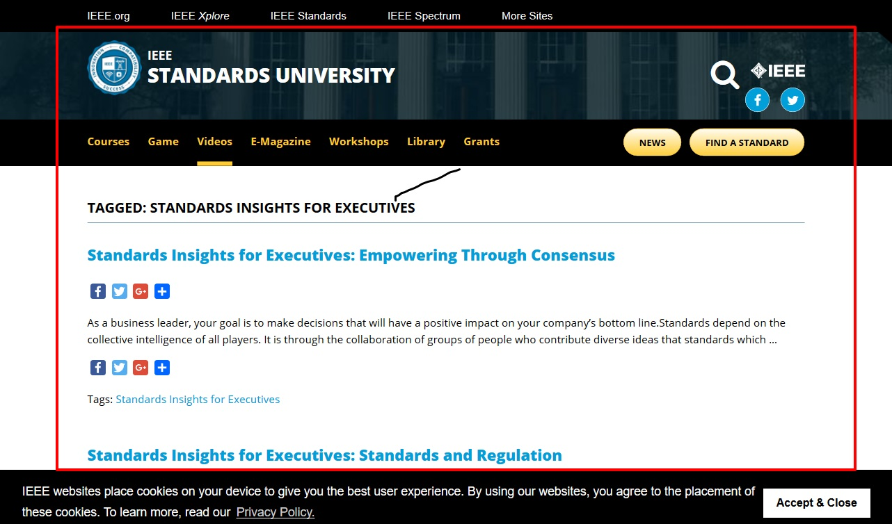

Slide 26
To get more information about IEEE Standards Association, please contact:
Standards.ieee.org

Slide 28
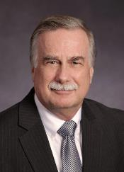
He has been involved in product strategy and standards activities since 1994. He has participated in various standards development organizations such as ETSI BRAN, ITU-R, GSC and ISO/JTC1, as well as in industry groups such as NIST/Smart Grid Interoperability Panel, Open SG, Bluetooth, ZigBee and the Wi-Fi Alliance. A large portion of time was spent within the Wi-Fi Alliance where he chaired several working groups and served on the board as the Conexant representative and Vice Chair of the BoD. He has travelled extensively in Europe and Asia for meetings with government ministries, company discussions and presented at conferences on topics such as 802 communication technologies, 5G, robotics, internet policies, connected and intelligent vehicles, power engineering, and engineering ethics. Within the IEEE he served 6 years as chair of 802.11n followed by, 6 years as 802.11 chair and a member of the 802 Executive Committee. During that period of time within the IEEE Standards Association he also served as a member of RevCom, AudCom and the Board of Governors. Upon leaving the position of 802.11 chair, Mr Kraemer served as President of the IEEE Standards Association during 2015 and 2016 where he chaired the Standards Association Board of Governors and served as a Director on the IEEE Board of Directors. At present he has been assigned to a variety of IEEE board committees including: Internet Initiative, Strategic Planning, Industry engagement, Corporate Governance, Committee on China Strategy, Public Policy Activities, Strategic Alignment & Oversight and Executive Director Search.
Bruce Kraemer
IEEE Standards Association President (2015-2016)
IEEE 802.11 WG Past Chair (2008 – 2014)

