Slide 1
An Overview of the IEEE Publishing Organization
For MGA Volunteer Leadership Training
IEEE Publications
Update May 2017

Slide 2
IEEE’s Strategic Mission:
“We foster technological innovation and excellence for the benefit of humanity. . .”
PSPB’s Strategic Goal:
“Be the resource of choice for information and services that technical professionals consider essential to their success.”
(Some of…) PSPB’s 3-5 Year Goals:
#1 – Content: Diversify content and delivery, including to industry users, while maintaining quality, brand, and reputation of IEEE.
#2 – Services: Increasing efficiency, productivity, and economic performance, while delivering new user-centric services.
#3 – Business Models: IEEE will have a coordinated, strategic, range of business models that reflect market trends and needs of customers.
#4 – Organization: IEEE will operate with attitudes and processes aligned to support a coordinated strategy for ALL its IP and content.

Slide 3
PSPB Serves The Entire IEEE and Has Members From Across The IEEE
IEEE Board of Directors
Educational Activities Board (EAB)
Technical Activities Board (TAB)
Member & Geographic Activities Bd. (MGA)
Publication Services & Products Bd. (PSPB)
Standards Assoc.
IEEE USA
Up to 30 members, specific members from EAB, USA, MGA, TAB, Standards, Comp. Soc.

Slide 4
PSPB, TAB, & Other Relevant Committees
IEEE Board of Directors
Publication Services & Products Board (PSPB)
Technical Activities Board (TAB)
Member & Geographic Activities Board (MGA)
Educational Activities Board (EAB)
TAB/PSPB Products & Services Committee
TAB Periodicals Review & Advisory Committee
Standards Board
IEEE Conferences Comm.
(Board Committee Administered by TAB)
IEEE USA
PSPB Pubs Conduct Committee
Finance Committee (FinCom)
PSPB Strategic Planning Committee

Slide 5
PSPB Is Delegated Responsibility For Operations & Quality of Information Products & Services
All “publication” types
Periodicals: Journals and Transactions, Magazines, Newsletters
Conference Proceedings
Books
Web Sites
All aspects of publishing activities
Editorial responsibilities of authors, reviewers, editors-in-chief
Guidelines for quality, peer review, handling of misconduct (e.g. plagiarism )
Copyright and re-use rights of authors and readers
Advertising policies and operations

Slide 6
PSPB and the IEEE as a Publisher
The IEEE is an STM publisher.
As a publisher, the IEEE is a business and operates in a competitive environment. It is staffed by industry professionals who participate in industry-wide technology and policy activities.
The Pubs OU represents the IEEE in the STM publisher landscape, including participation in publisher consortia and projects (e.g., CrossRef, CHORUS http://www.chorusaccess.org/, ORCID, RMap http://rmap-project.info/rmap/) and communicating with public policy makers.
PSPB is the mechanism by which volunteers participate in these activities.

Slide 7
What does IEEE Publications do?
Leads
Agrees and communicates (through Pubs SPC) the Strategic Plan for IEEE’s publications / products business
Maintains relationships with Editors and provides education and training to Authors and Reviewers which enhances the quality of IEEE publications and the entire scholarly communication community
Constantly improves services and cost base to provide the best quality and value for money for journal, conference, and book publishing partners inside and outside IEEE. Faster, cheaper, and better

Slide 8
What does IEEE Publications do?
Enables
Provides large-scale support for IEEE’s publishing activities (e.g. Xplore platform, S1M, author tools, B2B Sales [IEEE Media and recruitment revenues], and IEEE Spectrum)
Addresses publishing industry policy issues (e.g., open access content deposit and embargo periods, article sharing policy, and emerging data deposit requirements)
Develops and manages content, systems, and processes to be ready to power or be delivered by future products, or robust in future business models

Slide 9
Who we serve,
Content Creation
Editorial Production
Product Packaging
Delivery
Sales
Authors, Reviewers, Editors, of:
Journal or Conference articles (~50% not members)
Books
E-Courses
Standards
IEEE Org. Units With Info to Deliver:
Societies & Councils
Membership Activities
Local sections
Standards
Educational Activities
Awards
Corp. Activities
Pubs Dept. Serves entire IEEE
Outside orgs. who want to reach IEEE audience:
IET
IBM
MIT Press
ETRI
SMPTE
AGU
Readers and users of our services:
IEEE Member
Society Member
Non-Member Technical professional
Interested general public
Those who Purchase our products.
Individuals:
IEEE Members
Society Member
Non-member Technical Professionals
Institutions:
Academic Libraries
Corporations
Gov’t Agencies
Product Advertisers
Employers

Slide 10
Who we serve, and what we do for them
Content Creation
Editorial Production
Product Packaging
Delivery
Sales
Tools to help create technical articles
Journalist services to report and write news stories
Systems for peer review, plagiarism screening, and article flow
Tools and services to prepare documents once for both print and electronic media
Editorial proof reading
Illustrations and magazine covers
Page layout and production
Content tagging and indexing for e-delivery
Print issues
Bound volumes
Electronic databases with dynamic updates
Business rules to control access to online packages
Electronic
IEEE Xplore delivers PDF pages, XML text, multimedia, Video & audio
Access control supports variety of e-commerce models
Print
Printing and worldwide delivery
Subscriptions
work with member svcs. & institutional sales team
Advertising
IEEE Job Site (Classified ads)
Ads on Spectrum Web Site
Examining ads in context with search results

Slide 11
IEEE Periodicals Hit New Records while Conferences Continue Quality Initiative
2017F= 250,819 Articles Total
50,819 periodicals +64.6% vs 2006
200,000* conferences +64.1% vs 2006
Beginning 2011, output of conference articles declined resulting from the IEEE initiative to improve quality control for articles published in Xplore.
* 2017 articles based on article estimated counts as of Jan 2018 and are subject to change
Source: Articles published by IEEE by publication cover date
Notes:
Periodicals = Journals + Magazines: 2018 budget is for 46K Periodicals / 200K Conferences articles
In 2011 Conference articles began to decline then plateau due to the quality control initiative
Publication output has continued to grow on pace with global research output increases, placing economic strain on our current operating model.
NB: latest 2017 Pubs data indicating +17% and +13% YoY growth in Periodicals submissions and acceptance for publication respectively.
3/22/18
11

Slide 12
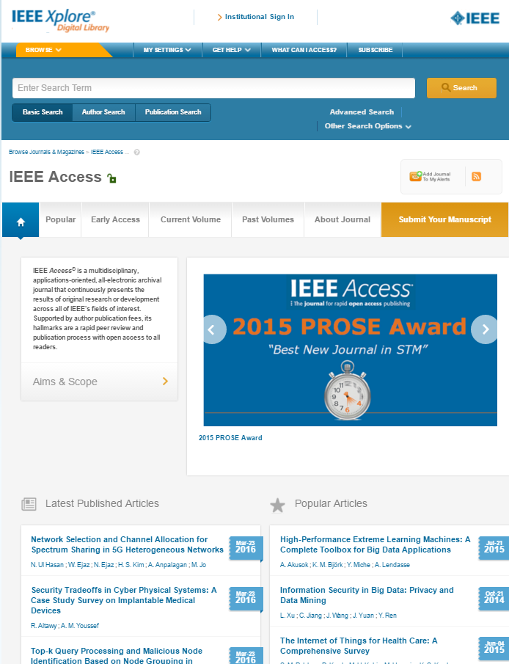
IEEE Access continues rapid growth:
The award-winning multidisciplinary journal has published over 1,000 articles on IEEE Xplore, after more than doubling the number of articles published every year
Many top 10 IEEE Xplore Most Popular articles are published in IEEE Access, based on monthly download statistics
Impact factor was awarded by Thomson-Reuters (now Clarivate Analytics) in 2016
12

Slide 13
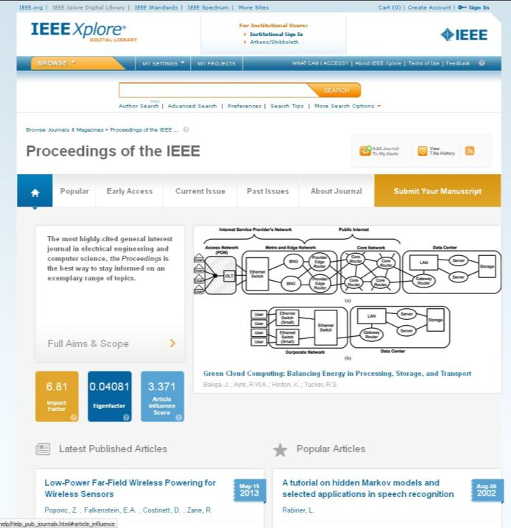
IEEE Xplore Enhanced
“Visual Abstract” highlights article of editor’s choice
New Alternate Bibliometrics put journal impact into perspective
Easier to find most frequently read articles – social measure of impact
1
2
1
3
2
3
13
Notes:
2017 Move to HTML-Full Text Article first – licensed users don’t get diverted to an Abstract Page before getting to the full article.

Slide 14
IEEE’s Open Access Program Fits Market Expectations
Outsell Report says that engineers are more skeptical about OA than scientists
Traditional journals, especially from professional associations, are still most popular
IEEE’s 3-component OA program offers authors a choice of open access or traditional journals

Slide 15
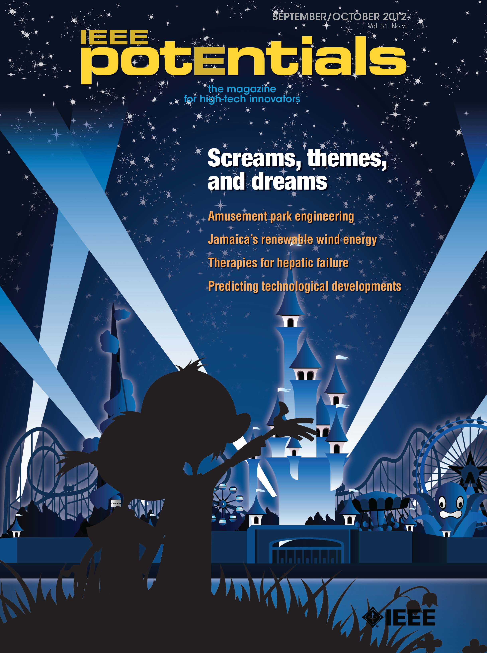
IEEE Publications Supports MGA
The APEX Awards for Publication Excellence is an international competition that recognizes outstanding publications from newsletters and magazines to annual reports and websites. All told, IEEE received a total of eight awards in the 2016 APEX competition. Other IEEE publications receiving recognition include:
IEEE-USA InSight in the Newsletter—Electronic and Email category.
The Institute in the Magazines, Journals and Tabloids category.
IEEE Women in Engineering Magazine in the Technical and Technology Writing category.
IEEE-USA Women in Engineering Compilation — Volume 1 in the One-of-a-Kind Publications — Electronic category.

Slide 16
IEEE Spectrum Supports MGA
Award-winning Magazine and Website adding 2016 Jesse H. Neal Awards for Best Website and Best Infographic to a long list of magazine industry honors
Members, Potential Members, and Educators the #1 Member Benefit ranked in survey results is provided by Spectrum in Print, Online, and Mobile
Chinese edition launched in 2012 is expanding the impact of IEEE in China

