Slide 1
Center for Leadership Excellence
Jill Gostin, IEEE R3 Director Elect
2018
6 October 2015
Notes:
20 minutes, Saturday at 2:05 pm

Slide 2

Designed to serve diverse IEEE user communities
https://ieee-elearning.org/CLE/
Simple to use, self-paced
Access with IEEE Account
Offers training for volunteers, conference planners, VoLT participants
Future modules will cover Micro-volunteers, new members, Region positions, and others

Slide 3
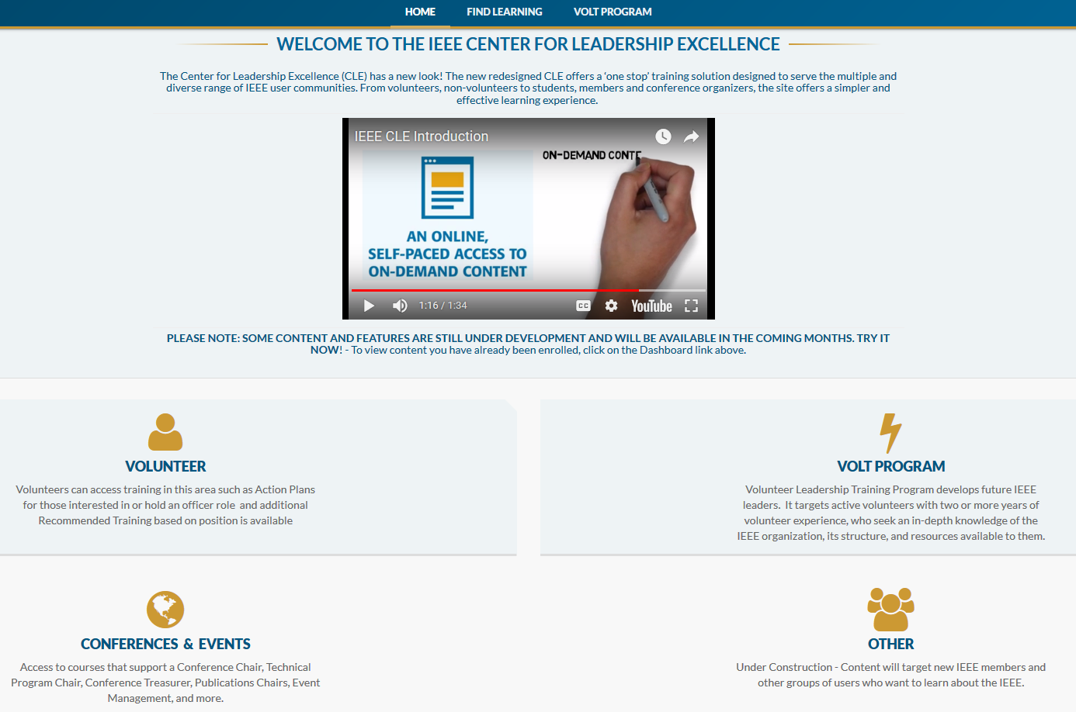

Slide 4
Volunteer Roles Action Plans available in CLE
Section Chair
Section Vice Chair
Section Treasurer
Section Secretary
Section Technical Chapter Chair
Section Membership Development Chair
Section Student Activities Chair
Section Nominations & Appointments Chair
Section Professional Activities Chair
Section Awards and Recognition Chair
Section Educational Activities Chair
Section Industry Relations Chair
Student Branch Chair
Student Branch Vice Chair
Student Branch Secretary
Student Branch Treasurer
Student Branch Counselor
Student Branch Chapter Chair
Section Student Representative
Section Student Branch Mentor
Section Young Professionals AG Chair
Section Life Member AG Chair
Section Women in Engineering AG Chair
Section Consultants Network AG Chair
Content targeted to: Section, Chapter, Student Branch, Affinity Group

Slide 5
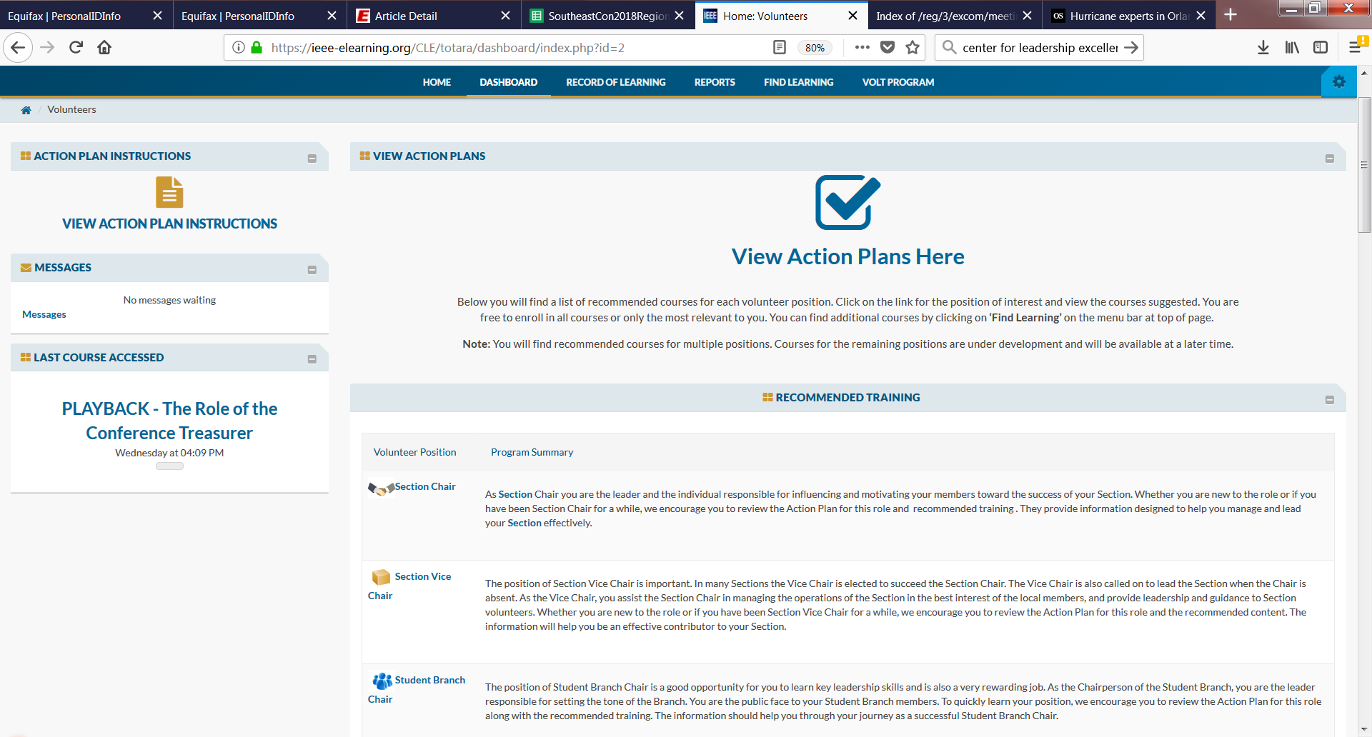

Slide 6
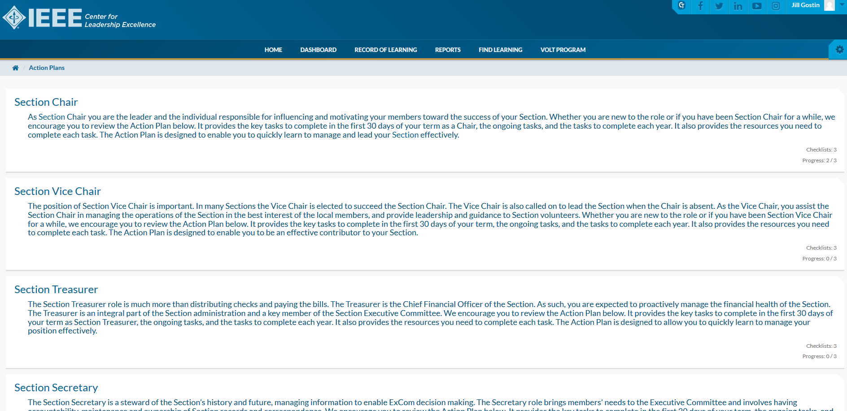

Slide 7
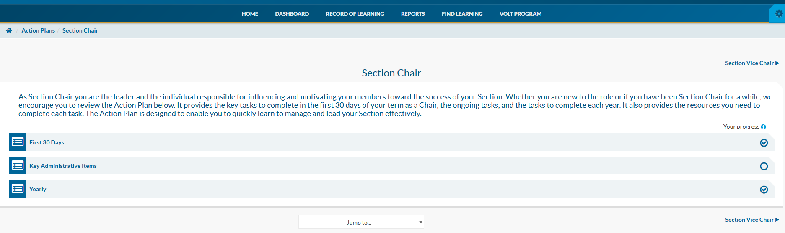

Slide 8
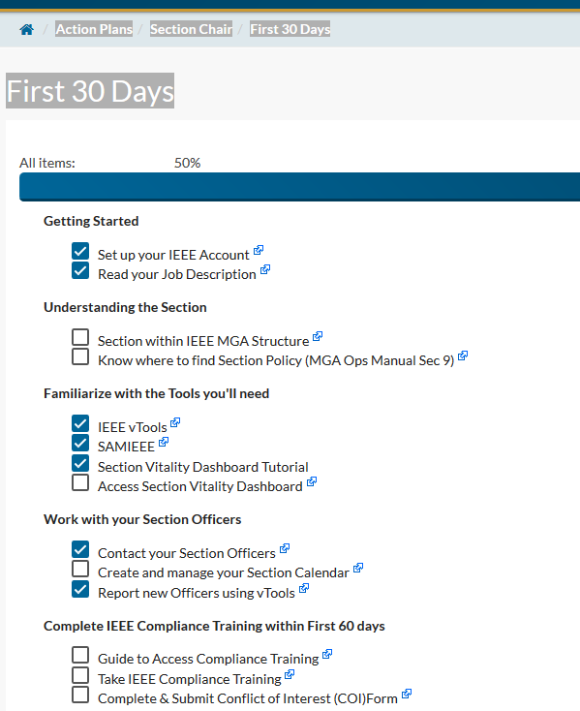

First 30 Days

Slide 9
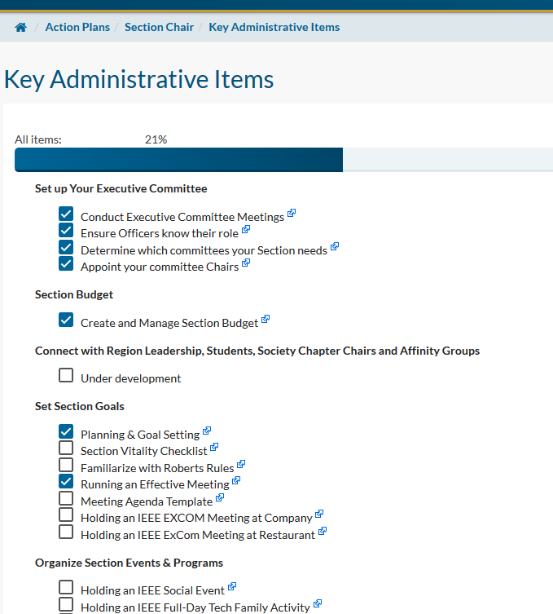

Key Administrative Items (ongoing)

Slide 10
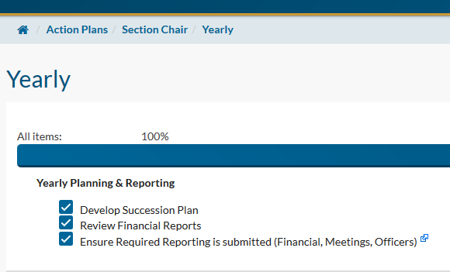

Yearly

Slide 11
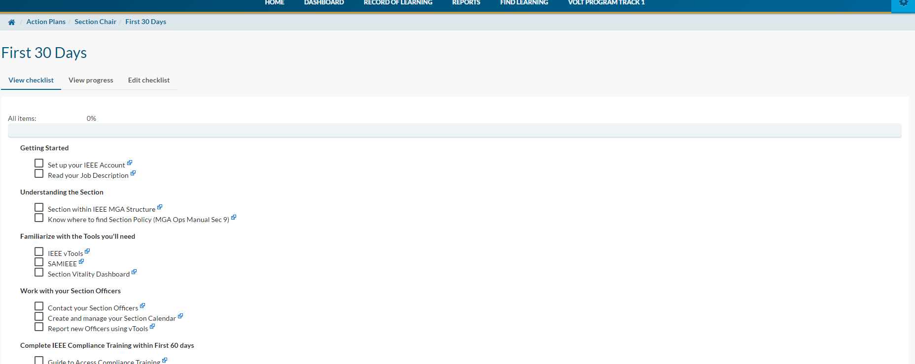
Tasks have links to Information Resources
Takes you to the content source

Slide 14
Recommended Training (Courses)
Sorted by Category
Leadership (strategic, interpersonal)
Management (day-to-day)
IEEE Awareness (incl. tools)
Business & Technology (incl. finance, ethics)
Member Engagement
Communication (verbal, written)

Slide 15
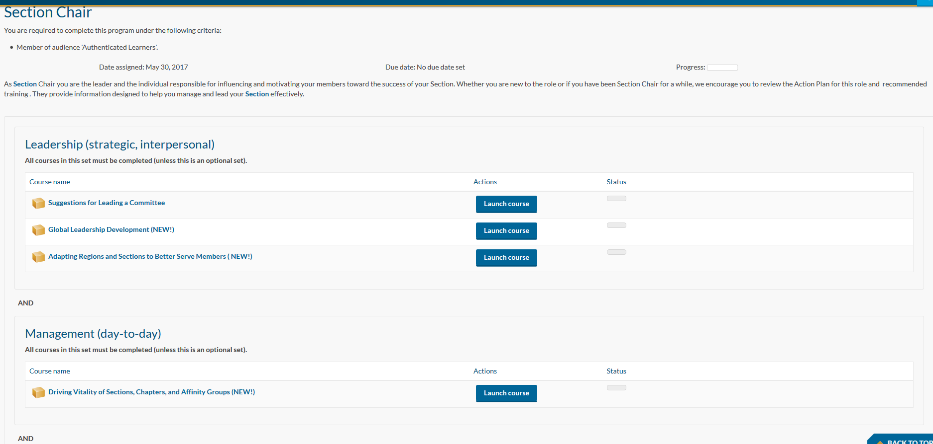

Slide 16
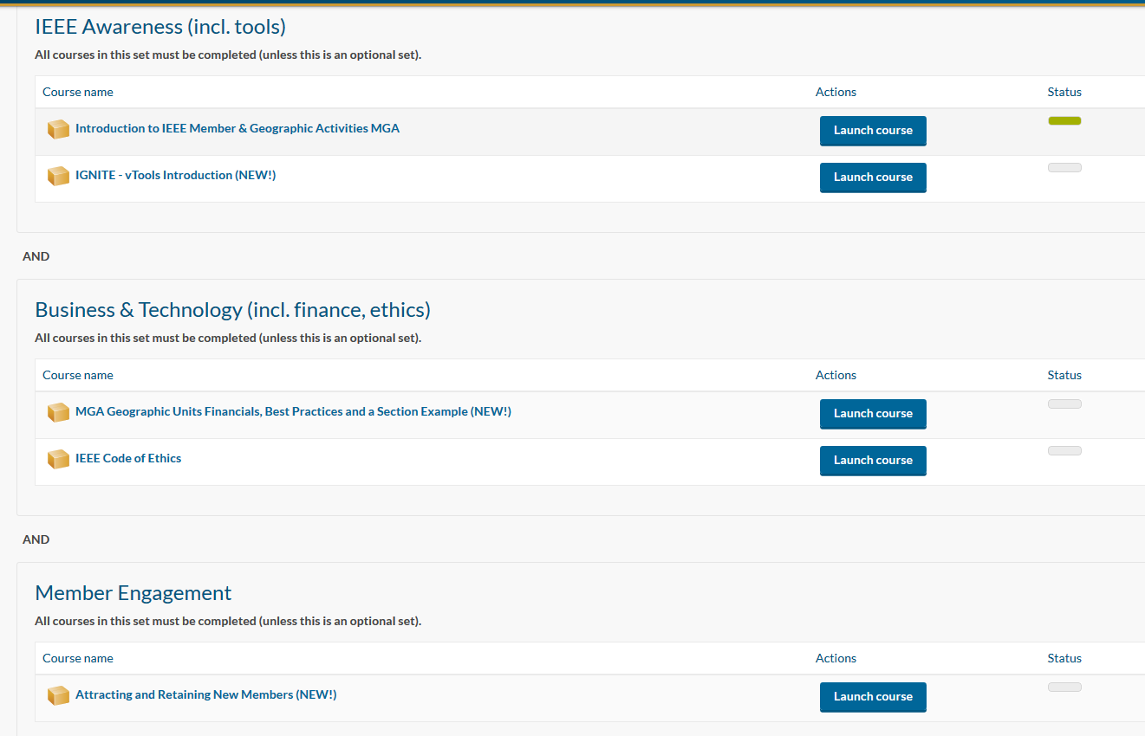

Slide 17
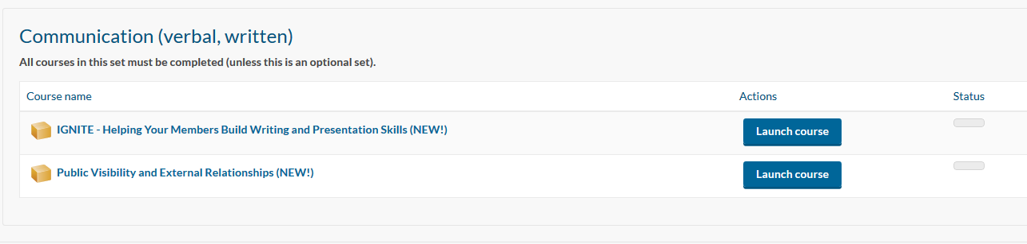

Slide 18
Added New Content to CLE!!
On top menu, select ‘Find Learning’-click on ‘Courses’ to search
Added >80 sessions Jan-Mar 2018
  SC2017 Ignites (5 min long)
  Speakers recorded individually with IEEE.tv while in Sydney
  Content covers broad topics (IEEE OUs, Technology)
Removing/Refreshing outdated content
Identifying Gaps

Slide 20
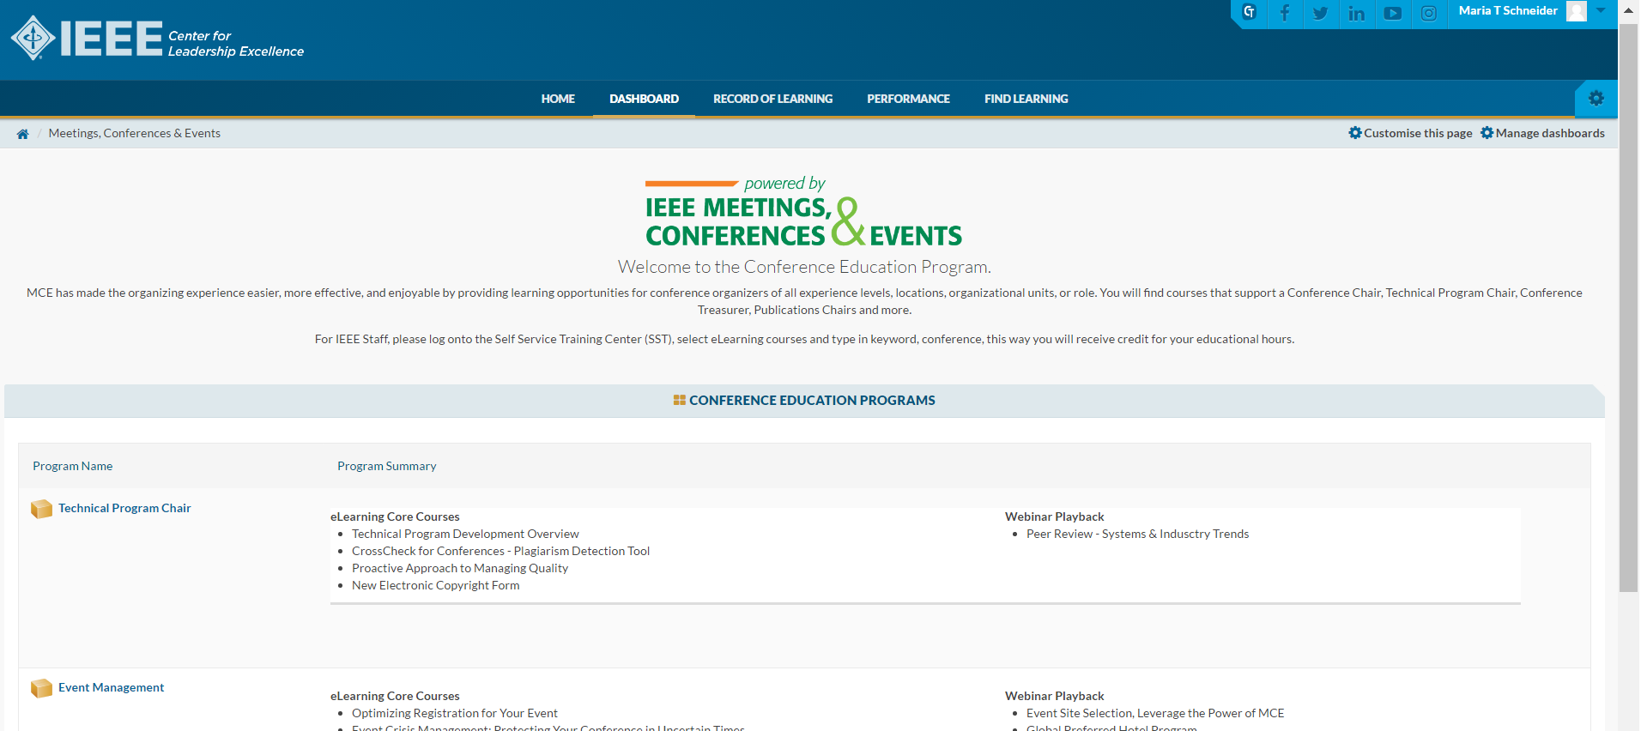

Slide 21
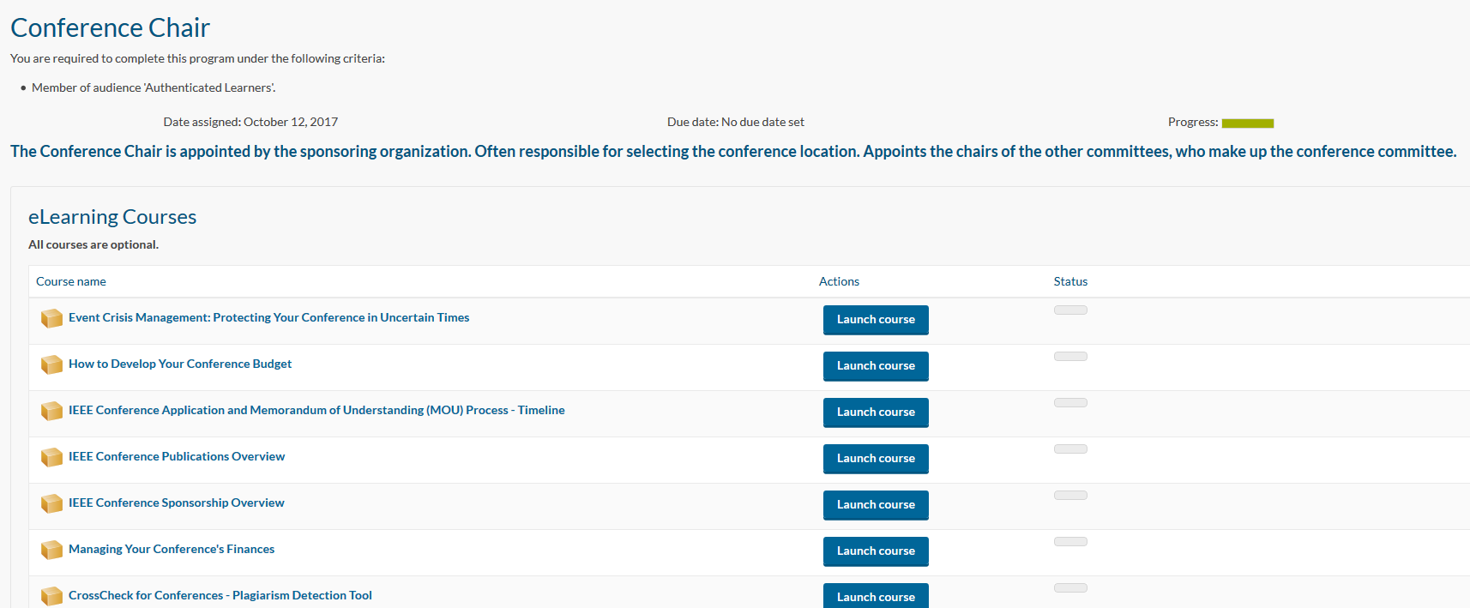

Slide 23
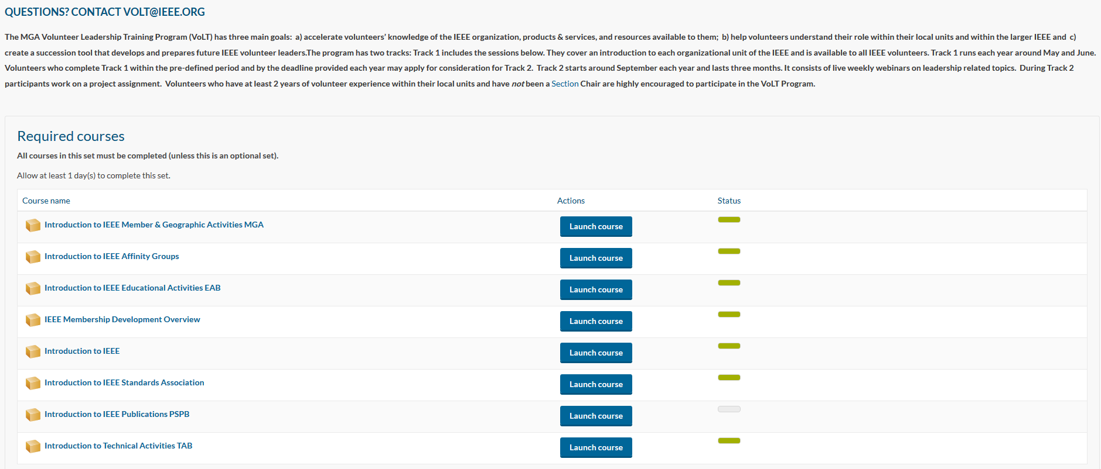

Slide 24
VoLT- From Pilot to Implementation
Successful Multi-year implementation
  2013 Pilot - 21 participants
  Started as a 6-month project
  By end 2017 VoLT had >180 volunteer graduates
Program tracks
        Track 1 – Offered in CLE – May-June 2018
        Track 2 - 3-month weekly live sessions via WebEx – Sep-Dec 2018
2017 Program
  >260 completed Track 1
  >100 applications received
  39 Mentors participated
  13 Project Teams from all IEEE Regions
    Top 3 projects present to MGA Leadership
Look for 2018 VoLT details in MGA SCOOP!
Notes:
2013 Pilot – Ralph Ford

Slide 25
Leveraging Training Materials

Slide 26
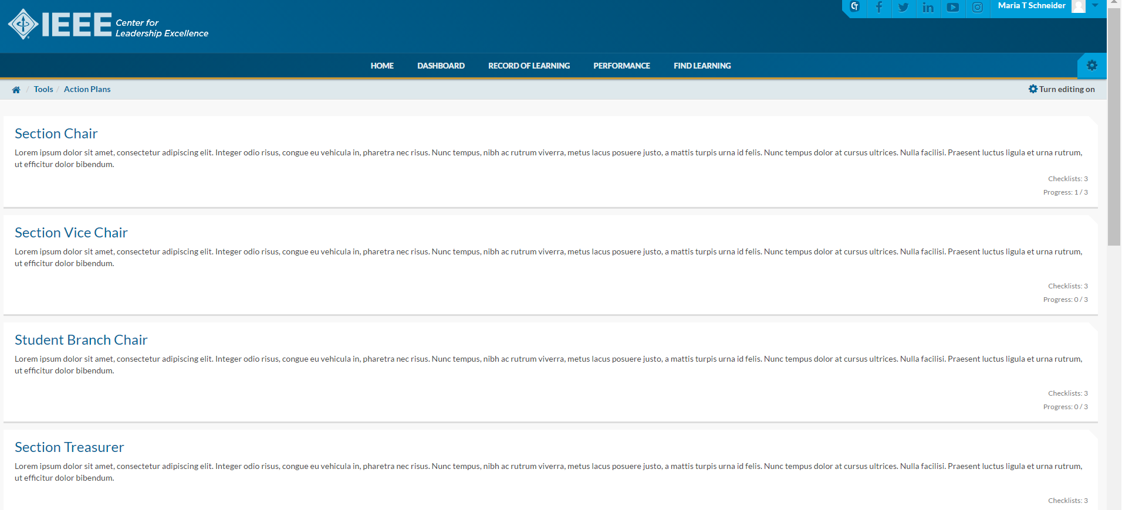
Develop Training Program for Officers
Request elected officers to review Action Plans for the position in CLE
Invite new officers to face-to-face training and planning session
  Recommend holding within one month after election
Promote dialog and Q&A among team members
  Ensure roles and responsibilities are clear
ACTION PLANS help volunteers learn about a new position in advance and decide if you want to run for the position or not
Notes:
NA committee can ask candidates to review the action plan prior to commit to run

Slide 27
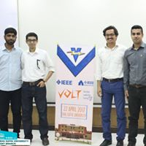
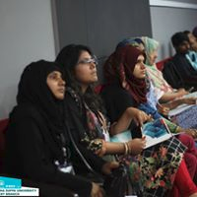
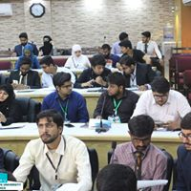

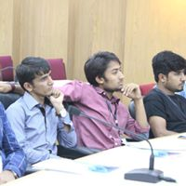
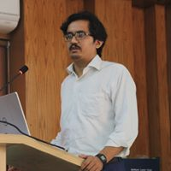
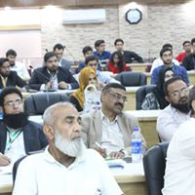
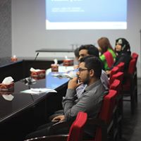

VoLT Graduate in Pakistan offers local training, increasing Section engagement
Full Day Workshop
60-80 people attend
Serve lunch and refreshments
Invite: Student Branches, YP
Section officers, SAC Chair, YP Chair, Education Chair deliver training
Section officers are trained and they are VoLT Grads too!!!!
Notes:
Karachi section now has 6 graduated ‘and trained’ VOLT leaders

Slide 28
Contact Information
  Diane Collier, 2018 MGA Training Committee Chair
  Email: dbcollier@ymail.com
  Maria Schneider, Senior Program Manager-MGA
  Email: m.t.Schneider@ieee.org - volt@ieee.org

