Slide 1
Professional Activities
Report to IEEE SoutheastCon 2018 on committee members, responsibilities, activities, and goals.

Slide 2
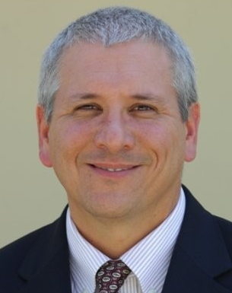
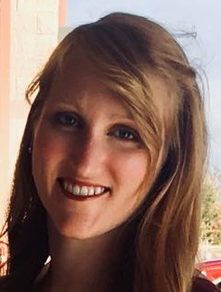
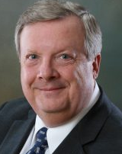
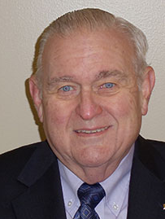
Professional Activities Committee
Committee Members for 2018
Chair: Theresa Brunasso
Professional Activities (USA-PACE)
Founder, D&S Microwave
Ed Kirchner
Employment & Career Services (USA-ECSC)
Engineering IPT Leader, Harris Corporation
Bailey Ulferts
Student Professional Awareness Coordinator
Controls Engineer, US Navy
Lee Stogner:
Government Activities Coordinator (USA-GAC)
President, Vincula Group
David Conner
STEM Educational Liaison (USA-K-12 STEM)
Professor & Chair Emeritus, UAB ECE Department

Slide 3
Professional Activities Committee
Committee Responsibilities
Encourage and support sections in ensuring the professional growth of members.
Work with others in the region to encourage, develop, and nurture programs that stimulate interest in STEM.
Submit the Professional Development Financial Report required by IEEE-USA.
Coordinate work to optimize the effectiveness of professional activities with federal, state and local governments.
Encourage student branches to hold events promoting professional awareness.

Slide 4
Professional Activities Committee
Activities and Goals for 2018
Distribute 100% of PACE funds to sections for professional events
Work with PACE committee and region to secure funds for future professional activities
Establish a short-term plan for employment activities in the region
Increase networking between students and professionals
Share information of region government activities
Participate in Congressional Visits Week in DC May 7-10
Produce a Government Activities webinar at the region
Provide funds and training for K-12 STEM volunteers

