Slide 1
IEEE MOVE Project
Grayson Randall, MOVE Driver and volunteer Mary Ellen Randall, MOVE Program Director
Notes:
Presenter, the following presentation is adaptable to your audience. Please see the notes sections for additional information, links, and other information that can improve the experience for your audience.

Slide 2
Our Mission:
To foster technological innovation and excellence for the benefit of humanity.
Our Vision:
To be essential to the global technical community and to technical professionals everywhere, and to be universally recognized for the contributions of technology and of technical professionals in improving global conditions.

Slide 3
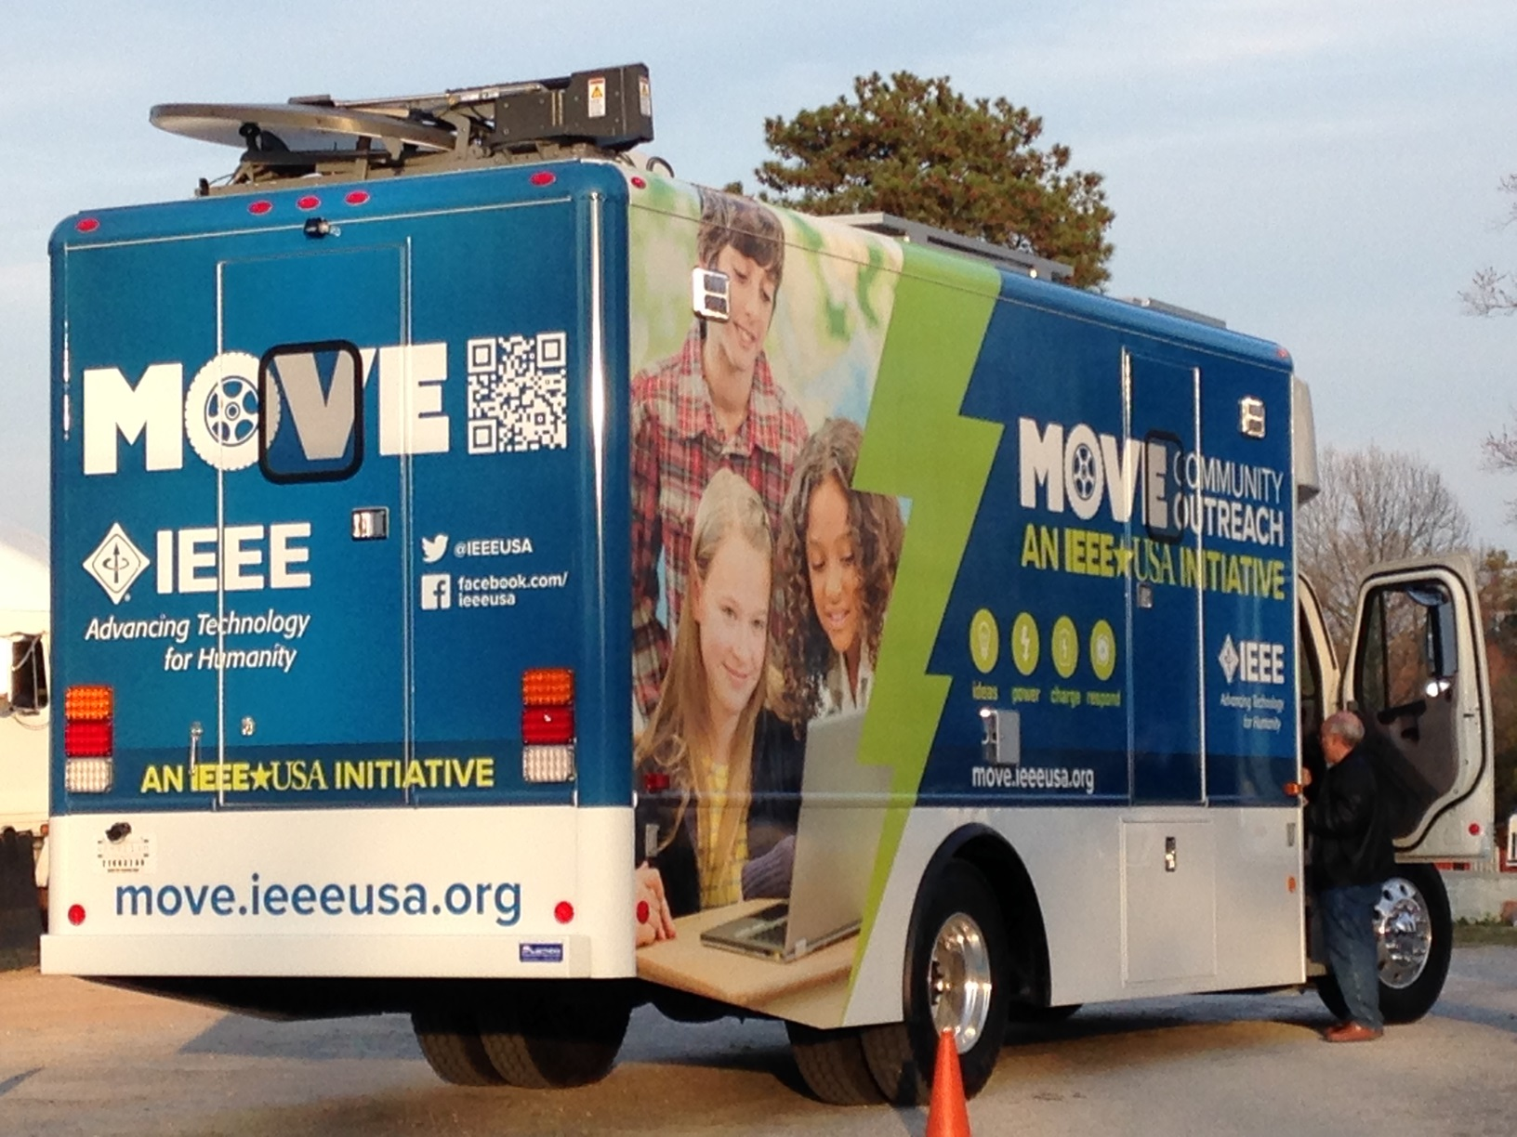
MOVE
Notes:
If you could walk into a store, and buy the shrink wrapped version of your software, what the design of the box look like and what would it say?
Point here is to get your team looking at your project through the eyes of your end customer.

Slide 4
MOVE: In a Nutshell
For Disaster Survivors
Who have survived the initial catastrophe,
MOVE (MObile VEhicle )
Is an IEEE Project that creates and operates a vehicle for disaster relief
That provides needed communications, light & power support to victims
Unlike some First Responder Efforts (e.g., ARRL, RACES)
Our project is intended to help the disaster survivors by supplying valuable services until normal infrastructure is restored.
Additionally it energizes the IEEE volunteer base, highlights skills, promotes public awareness and more

Slide 5
Goals
Provide communications, energy, light & information to disaster survivors
Give comfort to survivors
Provide communication, energy, information & light to disaster victims
Educational outreach to STEM students & Public
Engage Members through project involvement utilizing their technical skills
Share results widely, adapt to other regions
Build trained volunteer communities
Promote IEEE
Notes:
Write down all the reasons why your company would want to spend money on this project in the first place.
Then pick and highlight the most important one.

Slide 6
American Red Cross partnership
MOVE Deployment by ARC request at ARC Emergency Shelter
MOVE Services
Internet Access via WiFi (at MOVE, in shelter)
Power Bank distribution and recharge
Information distribution (printed hand-outs, video panels, satellite & local TV)
MOVE dependency on ARC
Shelter, food, sanitary facilities for IEEE volunteers (4-6)
Diesel fuel (after 3rd day) and/or AC power (220V/50A)
Official information for hand-out & video displays

Slide 7
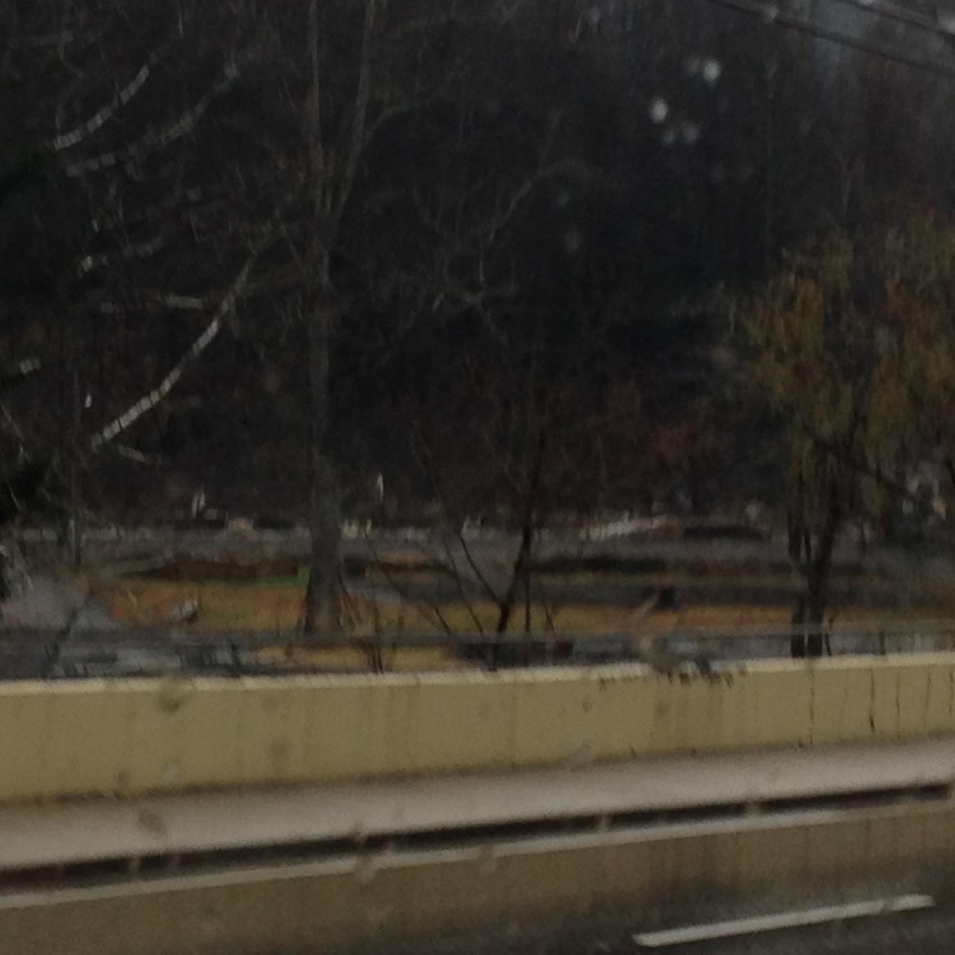
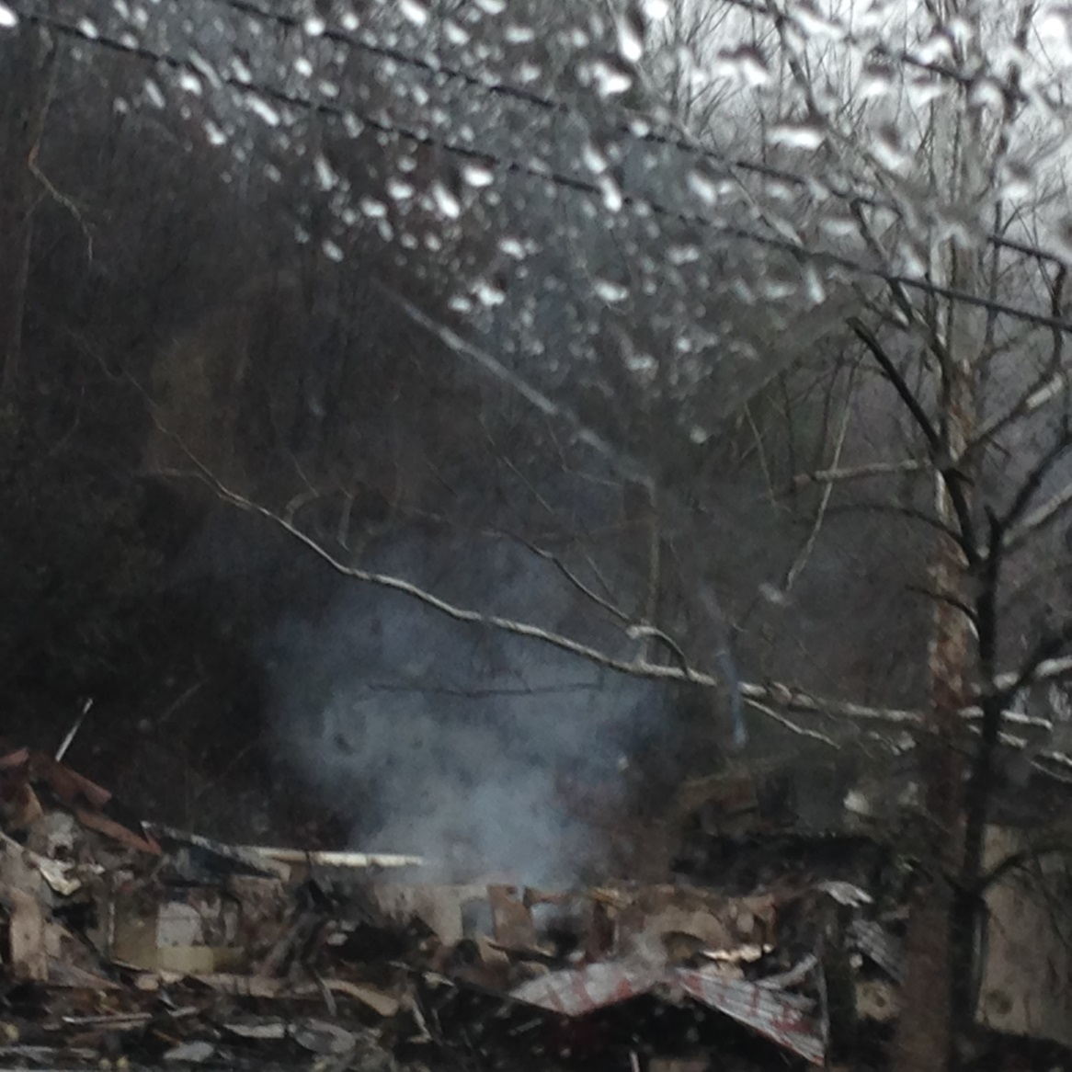
Tennessee Wild Fires

Slide 8
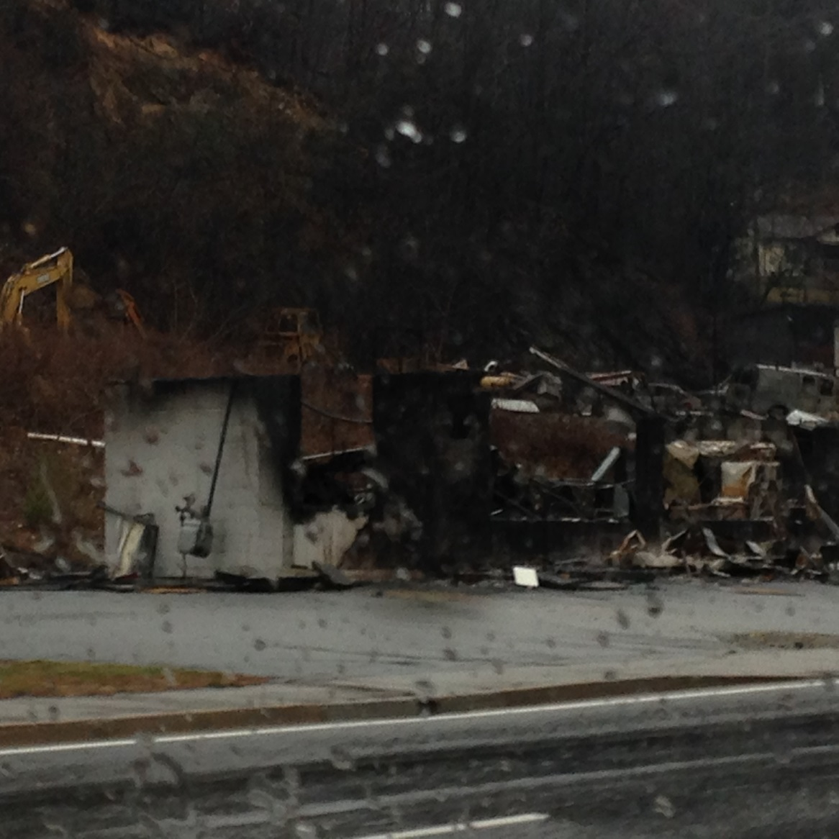
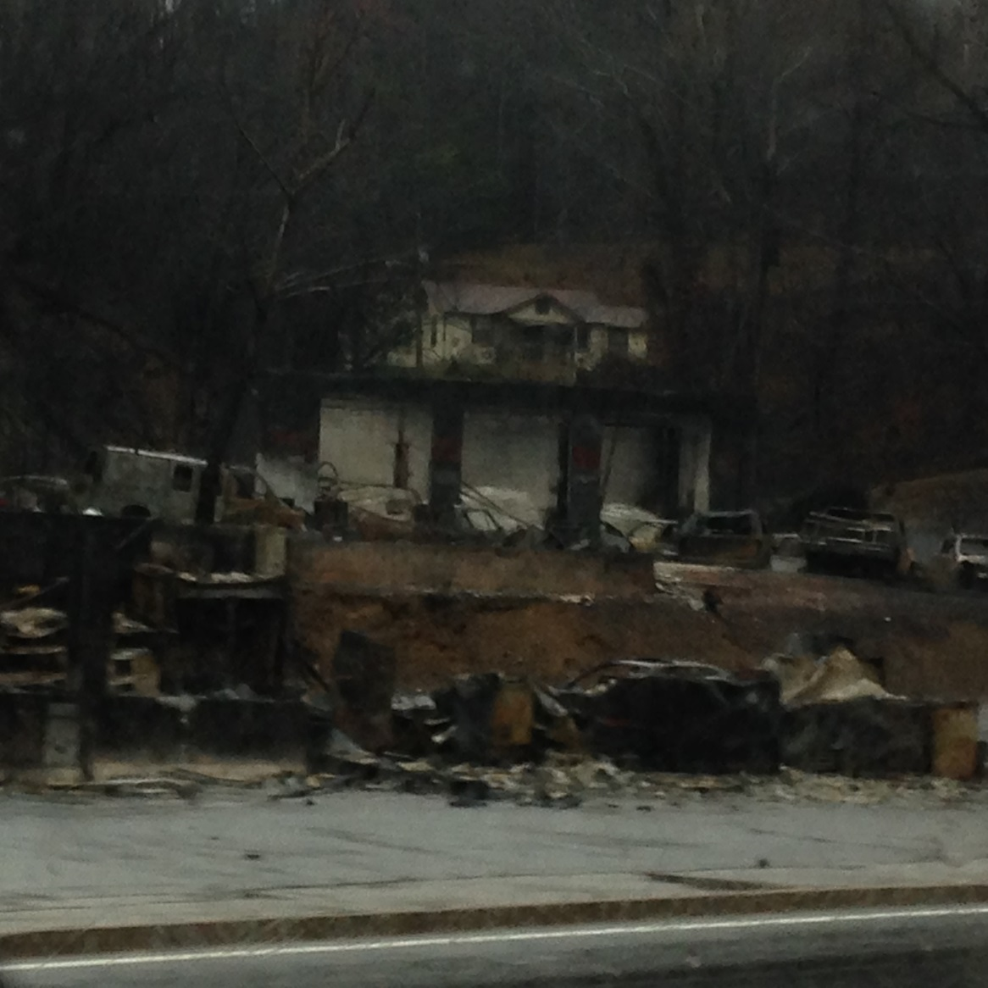
Gatlinburg, TN

Slide 9
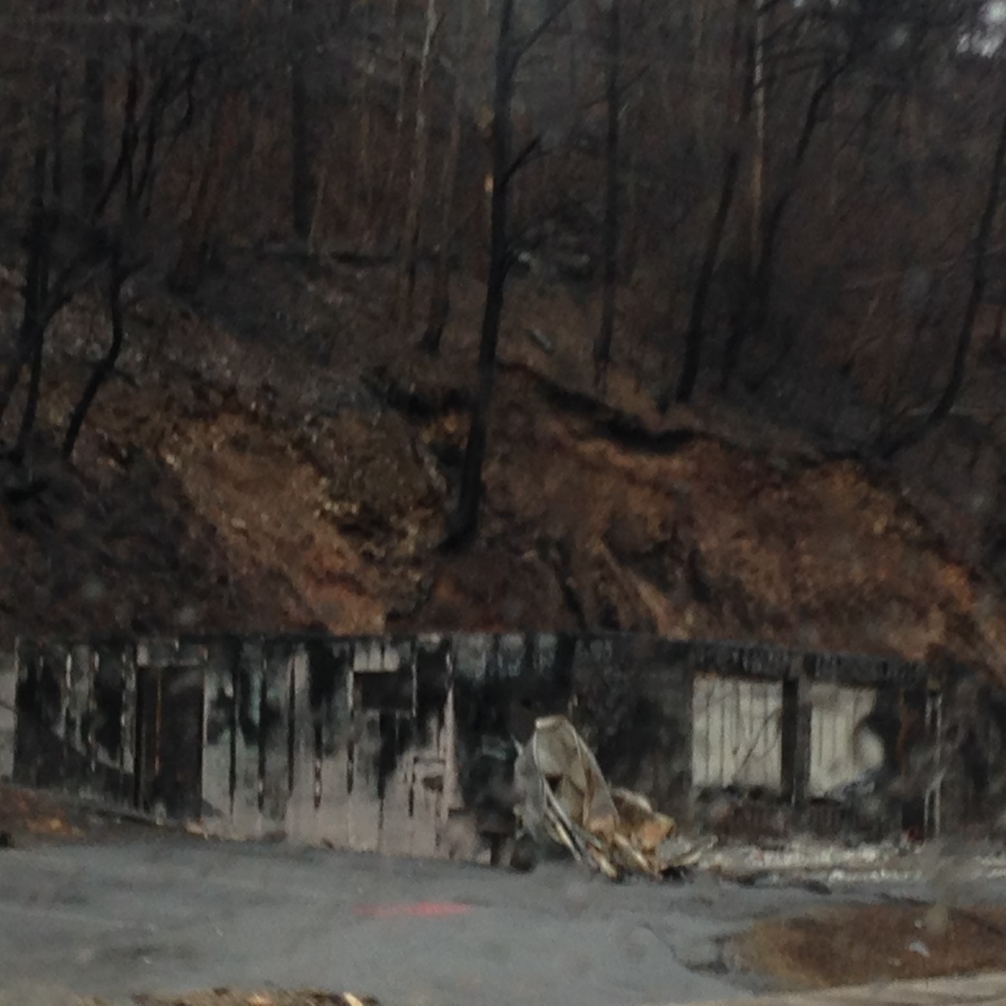
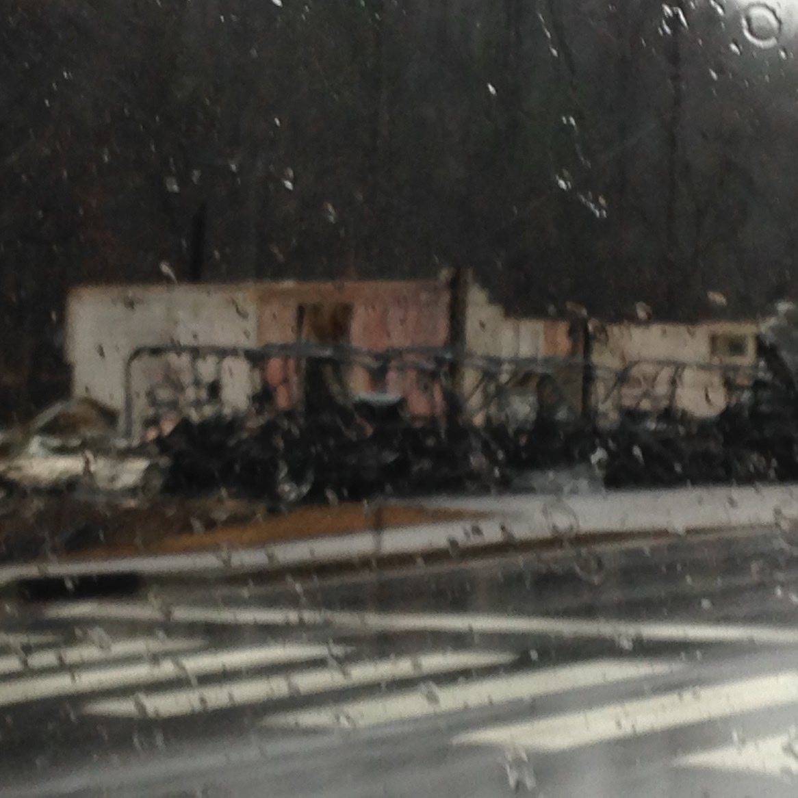
Businesses gone

Slide 10
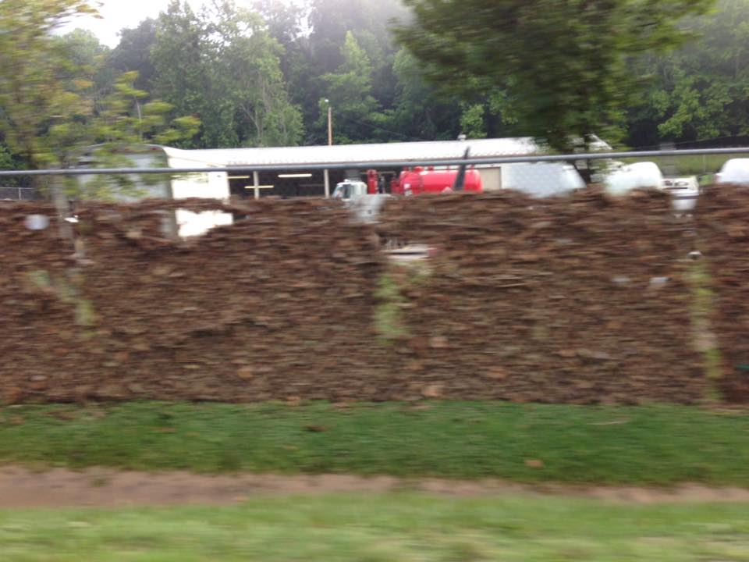
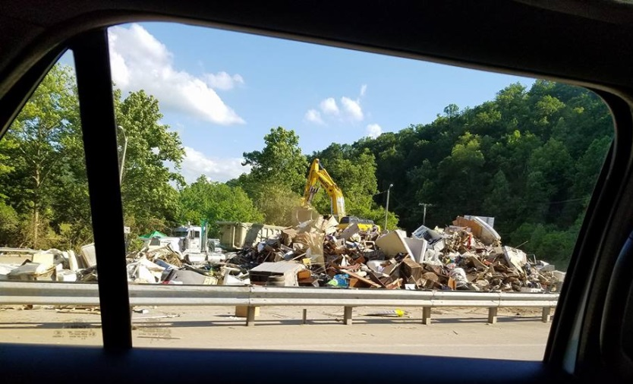
1,000 Year Flood in West Virginia

Slide 11
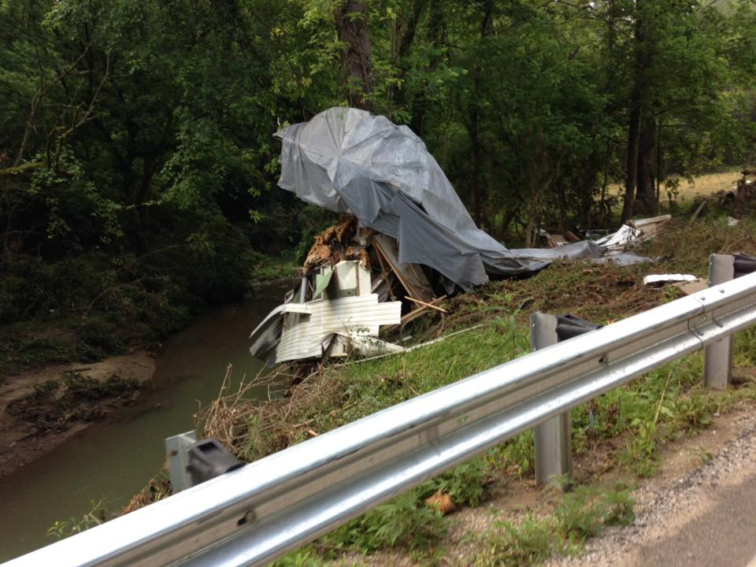
Road traveled
Whole homes were reported to be missing
Health hazards were real
Notes:
Take Emergen-C or similar product.

Slide 12
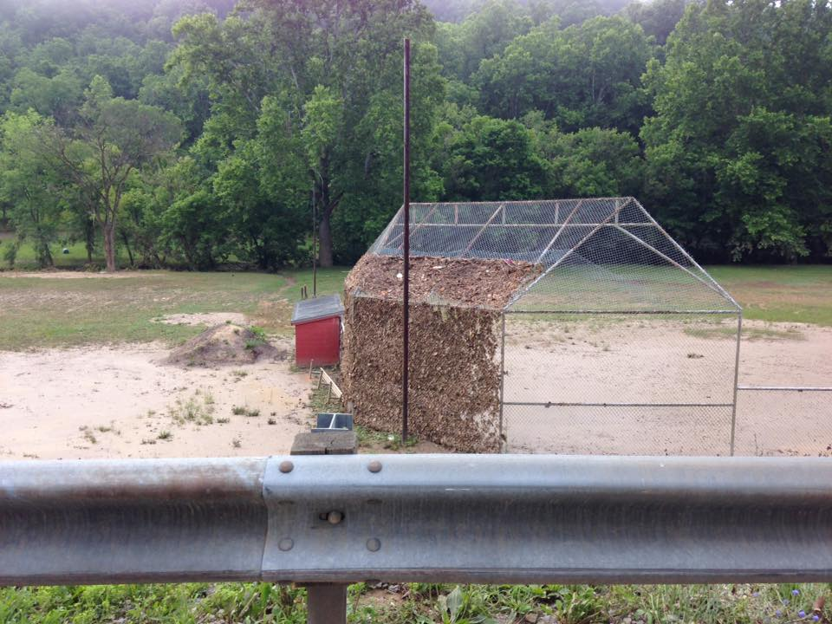
Red Cross Caseworkers work out of district office
Caseworkers locate those needing help
Food and shelter are available
Cleaning supplies are available and other bulk items

Slide 13
Result
“I've learned that
people will forget what you said,
people will forget what you did, but
people will never forget how you made them feel.”
Maya Angelou
Author & Poet

Slide 14
For More Information
g.randall@ieee.org Grayson Randall
merandall@ieee.org Mary Ellen Randall

Slide 15
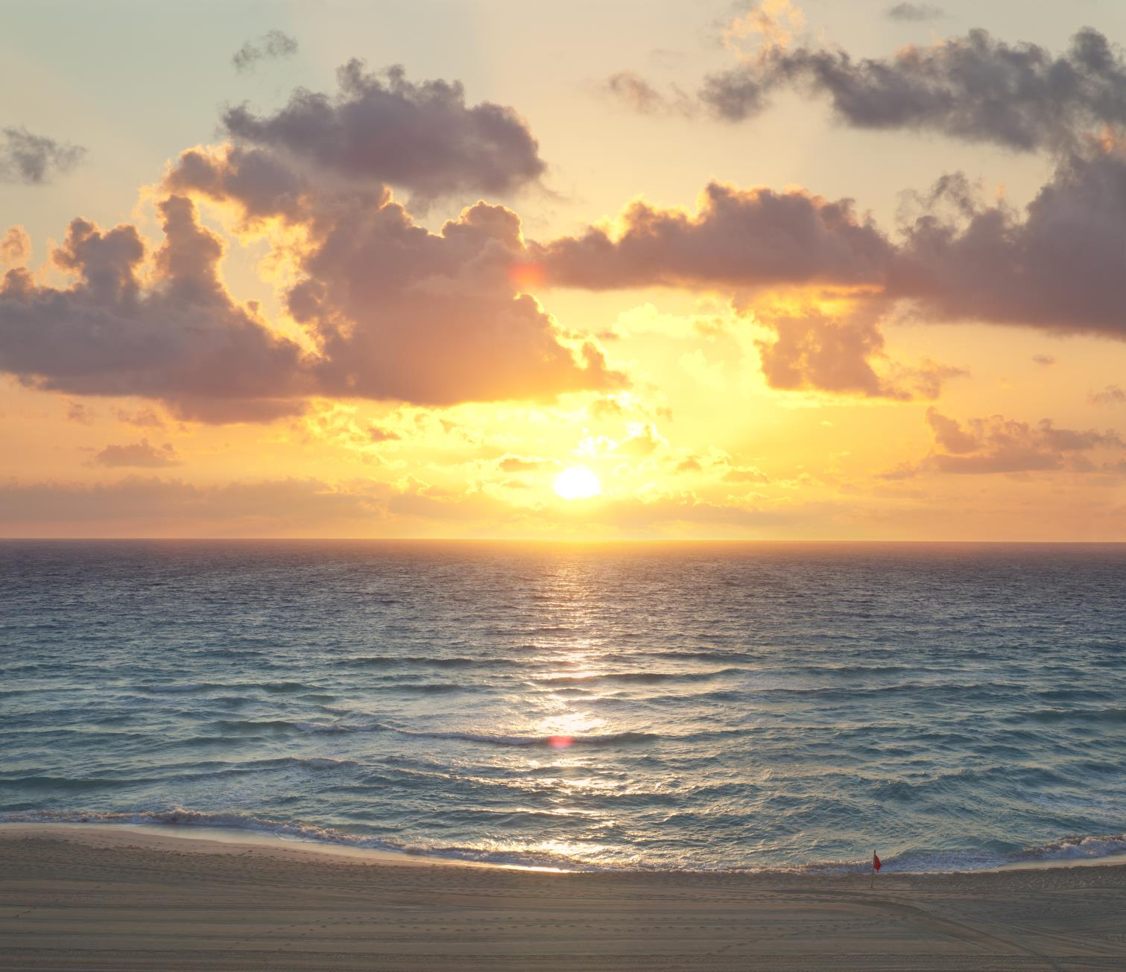
Together, we engineer a brighter future
Notes:
Presenter, optional quotes that you audience may find inspiring :
Thomas Alva Edison
“If I find 10,000 ways something won't work, I haven't failed. I am not discouraged, because every wrong attempt discarded is often a step forward.”
“Many of life's failures are people who did not realize how close they were to success when they gave up.”
Alexander Graham Bell
"The day will come when the man at the telephone will be able to see the distant person to whom he is speaking" (c.1906)
“The inventor is a man who looks around upon the world and is not contented with things as they are. He wants to improve whatever he sees, he wants to benefit the world; he is haunted by an idea. The spirit of invention possesses him, seeking materialization.”

