Slide 1
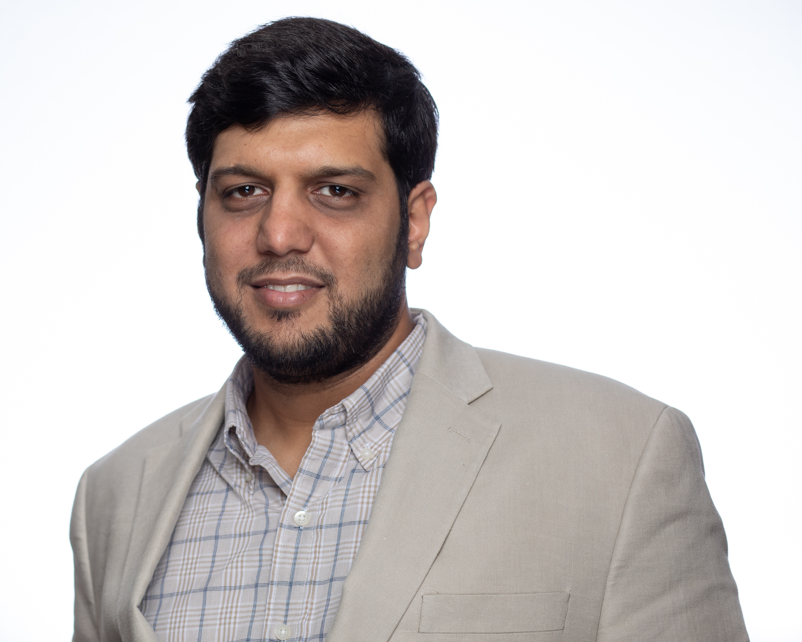
VoLT Program
Track 1: Section Foundations April 15th, 2023 @ 3:50 p.m.
Track 2: Section Growth --- April 15th, 2023 @ 4:35 p.m.
Tamseel Syed
Technical Activities Coordinator (R3 SSC)

Slide 2
R3 Technical Activities Coordinator Tamseel Syed
Interface between the Technical Chapters in Region 3 and the Region 3 ExCom.
Establish communication with Section Chairs and/or Section Chapter Coordinators via Area Chairs.
Acts as a resource to the Chapter officers.
Help resolve outstanding issues for existing Chapters.
Assist/encourage Chapter officer training.
Facilitate new chapter formation.
Assist existing Chapters to host at least 2 meetings a year.
Promote inter-Section/inter-Region collaboration.

Slide 3
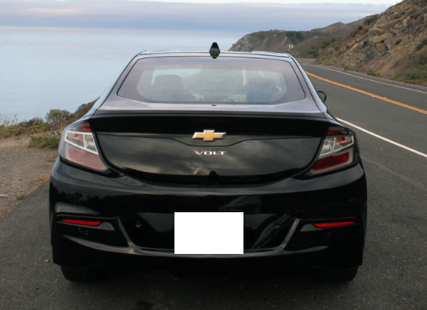
Guess the right VoLT
1. 2. 3. 4. 5.

Slide 4
Guess the right VoLT
1. 2. 3. 4. 5.

Slide 5
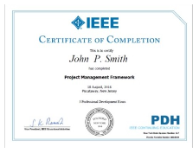
IEEE training opportunities
IEEE R3
WiKi pages
CeU/
PDH

Slide 6
What is VoLT
Volunteer Leadership Training Program
Prepares IEEE volunteers for leadership roles in their local units and beyond
VoLT Goals
Accelerate volunteers' knowledge of the IEEE's organization, products, services, and resources.
Help volunteers understand their roles within their local units and within the entire organization.
Create a succession tool that develops and prepares future IEEE volunteer leaders.

Slide 7
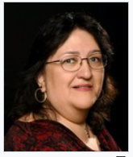
VoLT team
Run by IEEE Member & Geographic Activities (MGA) Board
Managed by Loretta Arellano
l.arellano@ieee.org
IEEE Staff Contact:
For questions? email: VoLT@ieee.org

Slide 8
VoLT success story
90% graduates
have become leaders in their OUs
45% of all Sections
250+ grads in VOLT Graduates community in Collaboratec

Slide 9
VoLT – R3 participation (19)
Graduate Name | Graduation Year | Geographic Unit | Region | Country | Graduate Email | Mentor
Melody Richardson | 2022 | Atlanta Section | 3 | United States | richardson.melody@gmail.com | Karen Panetta
Binesh Asok Kumar | 2022 | Charlotte Section | 3 | United States | binesh.kumar@ieee.org | Scott Tamashiro
Pankaj Kumar Bhowmik | 2022 | Charlotte Section | 3 | United States | bhowmikpankaj@ieee.org | Ivan E. Villalon-Turrubiates
Naznin Akter | 2022 | Miami Section | 3 | United States | nakte001@fiu.edu | Thomas Coughlin
Devon Lloyd Gayle | 2021 | Jamaica Section | 3 | Jamaica | d.gayle@ieee.org | Robert Iraido Ramírez Chávez
Eric Scott Cramer | 2020 | Melbourne Section | 3 | United States | eric.cramer@ieee.org | Marc Apter
Maxine Cohen | 2020 | Palm Beach Section | 3 | United States | cohenm@nova.edu | Koteswararao Tatipamula
Evelyn Licona | 2020 | Piedmont Section | 3 | United States | eplicona@gmail.com | Ed Palacio
Nelson Estacio Lourenco | 2019 | Atlanta Section | 3 | United States | nelson.lourenco@gtri.gatech.edu | Teofilo Ramos
Sharlene Nicola Brown | 2019 | Jamaica Section | 3 | Jamaica | sharlenenbrown@ieee.org | Pia Torres
Richard Thomas Kent Jr. | 2018 | Daytona Section | 3 | United States | RTKentJr@msn.com | David Fillion
Warren Macchi | 2018 | Orlando Section | 3 | United States | wmacchi@abamis.com | Kalyan K Sen
Hasala Dharmawardena | 2018 | Piedmont Section | 3 | United States | hasalaid@gmail.com | Parviz Famouri
Tamseel Mahmood Syed | 2017 | Atlanta Section | 3 | United States | syed.tamseel@gmail.com | Hossam Ali
Derik Leroi Pack | 2017 | Coastal South Carolina Section | 3 | United States | derik.pack@gmail.com | Parkash Lohana
Hernan Mauricio Cano | 2016 | Eastern North Carolina Section | 3 | United States | mcano@ieee.org | Rhonda Farrell
David Fillion | 2015 | Piedmont Section | 3 | United States | dfillion@ieee.org | Diane Colliler
Daniel Diaz-Lugo | 2014 | Atlanta Section | 3 | United States | dannyd4@gmail.com | Wai Chong (Lawrence) Wong
Phillip E Henson | 2014 | Huntsville Section | 3 | United States | phillip.henson@gmail.com | Norberto Lerendegui

Slide 10
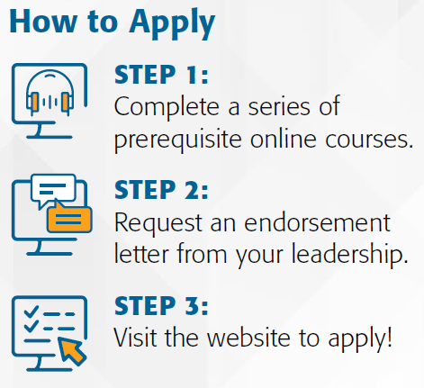
How to register
Track 1 Online
Track 2 starts
In
September
Every year
www.ieee.org/VoLT

Slide 11
Contents of application
A strong candidate for the VoLT Program will meet the following requirements:
An active IEEE membership
Completed all eight prerequisite courses
Two or more years of experience as an IEEE volunteer
Four or more years as an IEEE member
Is a Graduate Student Member or higher
An interest in becoming a future IEEE leader
An endorsement letter by a senior IEEE volunteer

Slide 12
VoLT program deliverables
Accepted candidates will be grouped in teams
Teams can bring up new ideas to help local OU
Business plan
Video of the presentation
Mentors panel selects top 3 projects each year

Slide 13
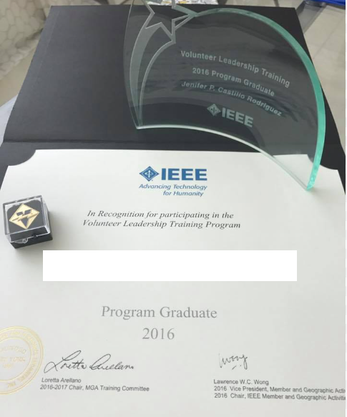
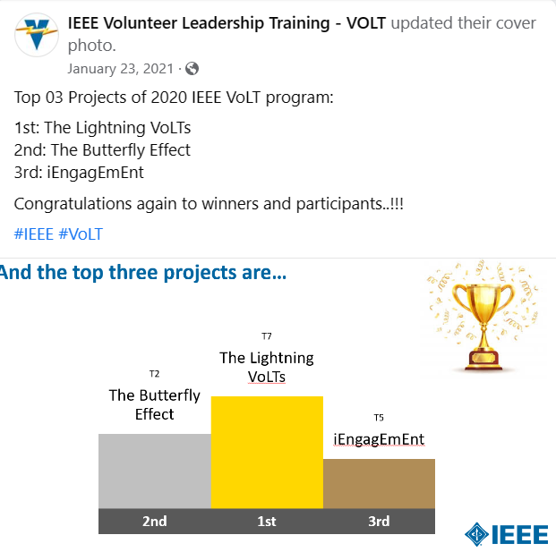
What do you get?
Be a part of
Global
VoLT network

Slide 14
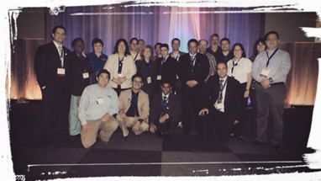
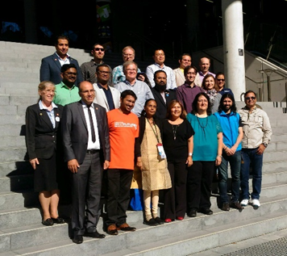
Luncheon at Sections Congress
2014
2017

Slide 15
Stay connected with VoLT
https://www.linkedin.com/company/ieee-volt
https://www.facebook.com/ieee.volt/
https://www.instagram.com/ieee_volt/

Slide 16
IEEE R3 Section Support Committee (SSC)
Stimulating interest of IEEE members
Motivating members to volunteer
Encouraging professional and technical growth of all members
Sharing best practices with other Sections
Forming Engineering Affinity Groups

Slide 17
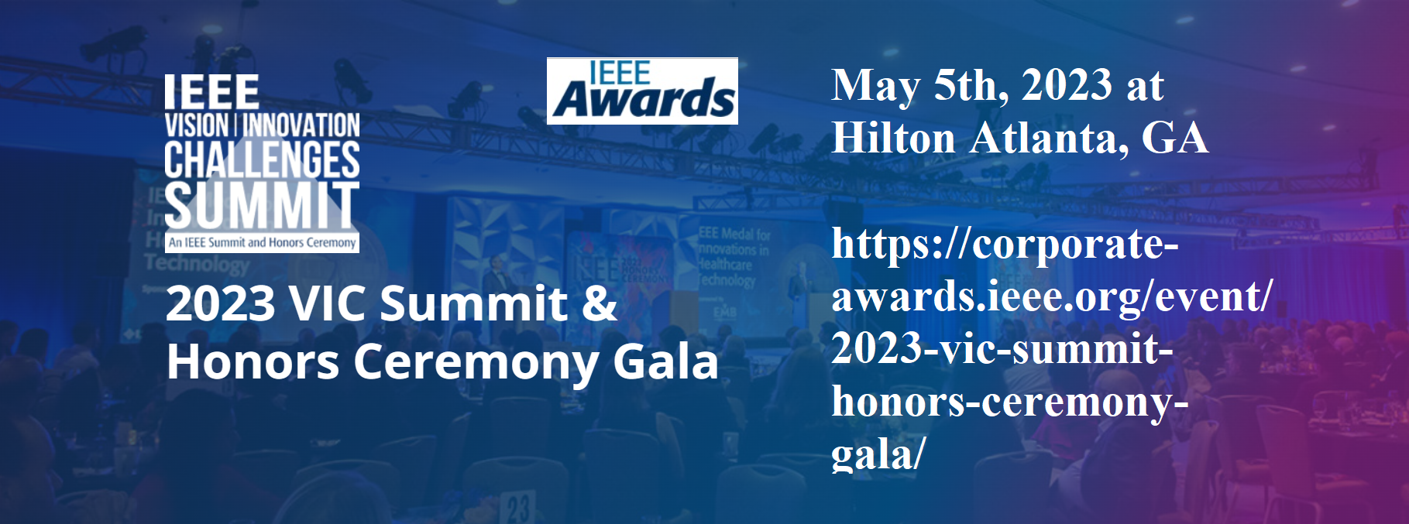
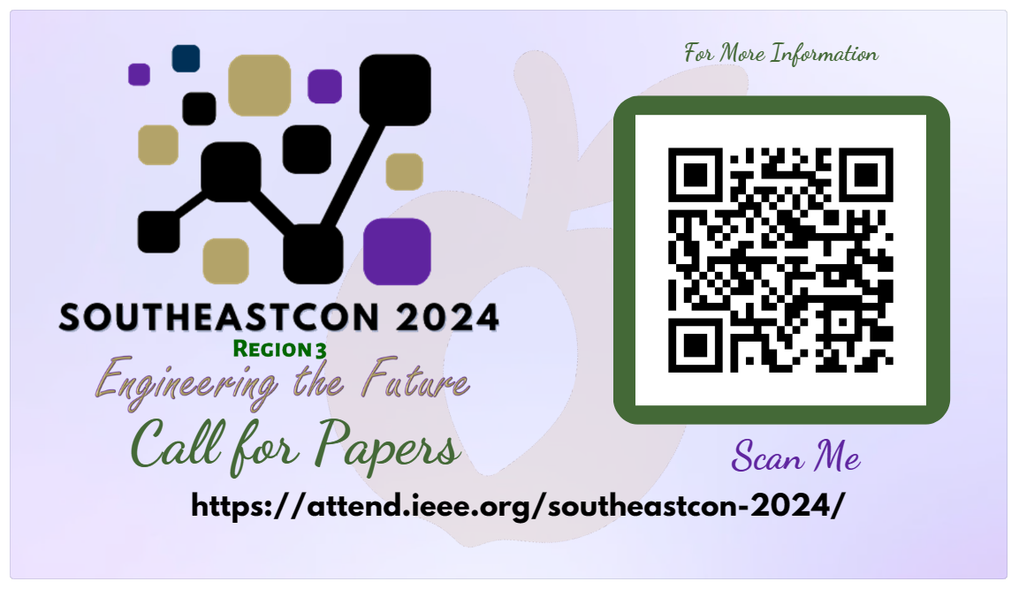
IEEE Atlanta Section
Save these Dates!!!

Slide 18
Tamseel Syed: syed.tamseel@ieee.org
VoLT Program questions: VoLT@ieee.org

