Slide 1

Region 3 Meeting | 10 AUG
Ottawa, Canada | 11–13 AUG

Slide 2
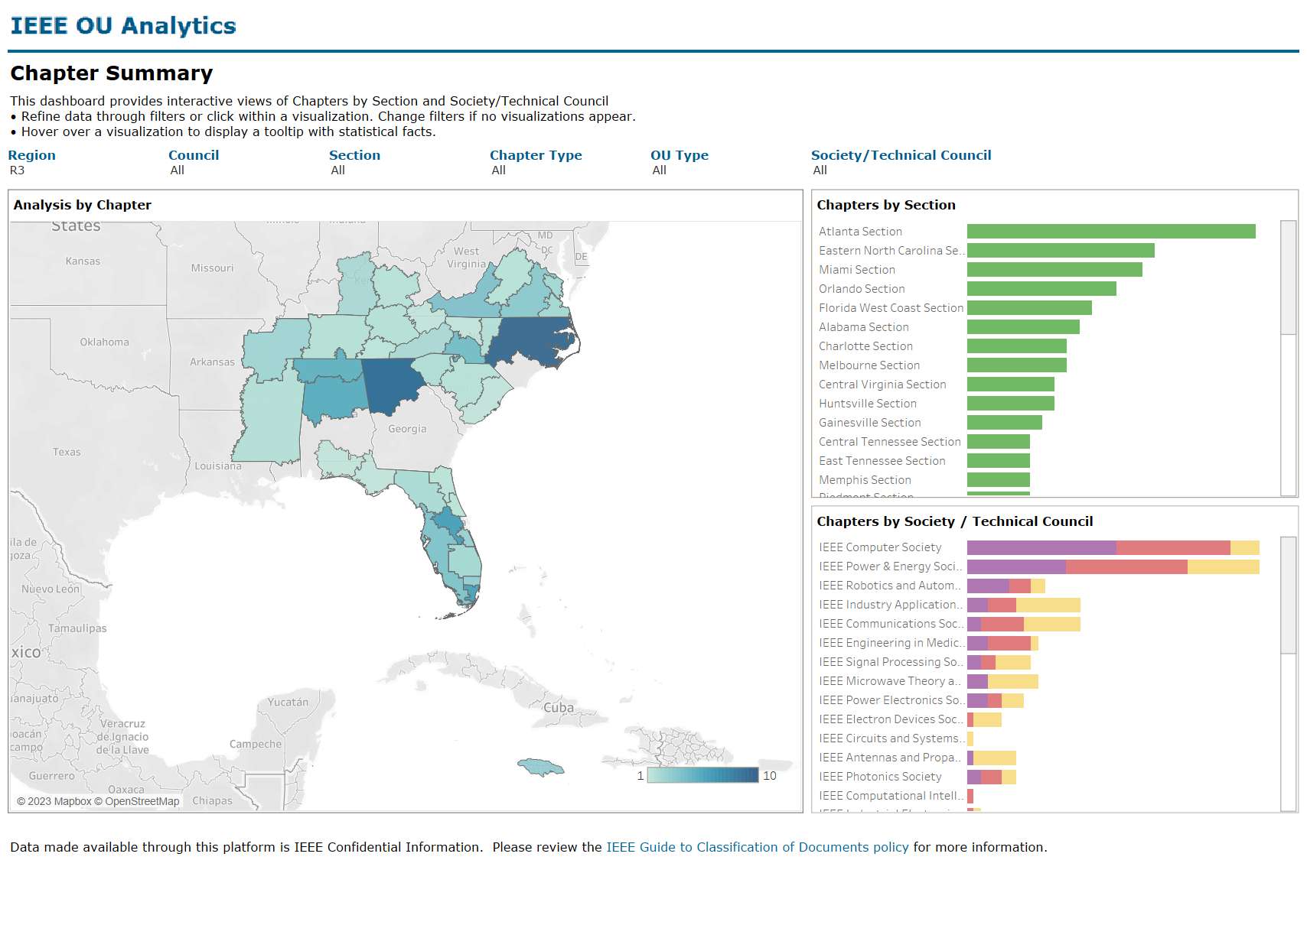
Starting and Growing Chapters
Presenter: Dr. Alessio Medda
Prepared by: Mr. Tamseel Syed
August 11th, 2023 @ 2:10 p.m.
R3 meeting at Sections Congress

Slide 3
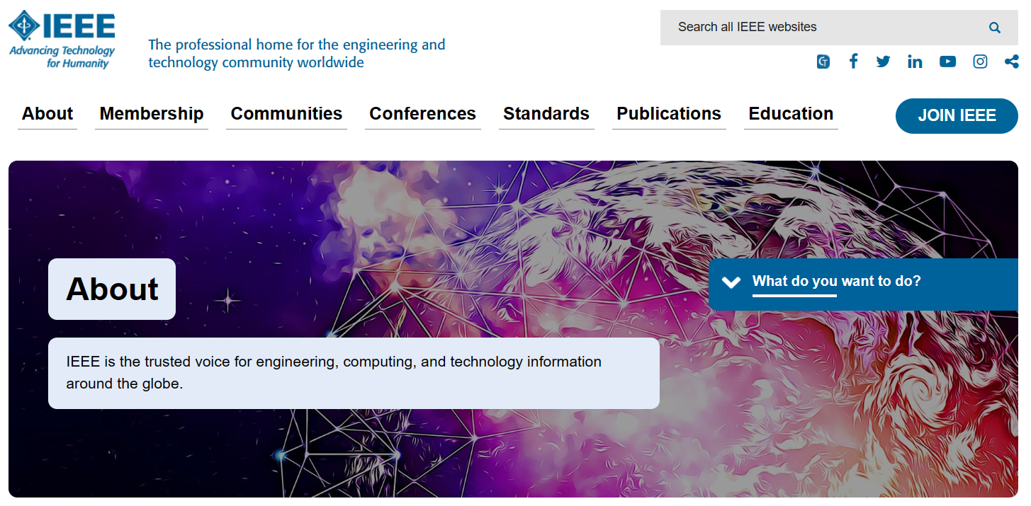
Technical Engagement
IEEE is comprised of members in Technical focus areas in Engineering
IEEE’s mission statement: “IEEE's core purpose is to foster technological innovation and excellence for the benefit of humanity.”
IEEE’s Vision: “IEEE will be essential to the global technical community and to technical professionals everywhere, and be universally recognized for the contributions of technology and of technical professionals in improving global conditions.”
FOCUS: TECHNICAL & TECHNOLOGY

Slide 4

Need for a local Technical Chapter/Affinity Group
Most members in IEEE are associated with one of the Technical Areas!
Also, members are usually categorized under one of the Affinity Groups!
38 Technical Societies
4 Affinity Groups
Having Chapters increases excitement for technical engagement in local OUs
Platform for like-minded engineers to collaborate
Learn more at: Chapters - IEEE Member and Geographic Activities

Slide 5
Chapters/Affinity Groups in IEEE R3
117 Chapters within R3
76 Affinity Groups within R3
Tremendous potential to add several more chapters

Slide 6
Benefits of having a local Technical Chapter/Affinity Group
Collaboration opportunities for engineers with common goals
Catalyst for Technical growth
An avenue to learn novel ideas for technical engagement
Share best practices with other technical chapters or affinity groups within the Section
Tool that provides continuous technical learning for engineers
Offers more value to IEEE membership
Increase member engagement.
Opportunities for member retention and membership growth
Tool to recruit more volunteers.
Create a list of enthusiastic volunteers for leadership succession plan

Slide 7
Starting New Chapters

Slide 8
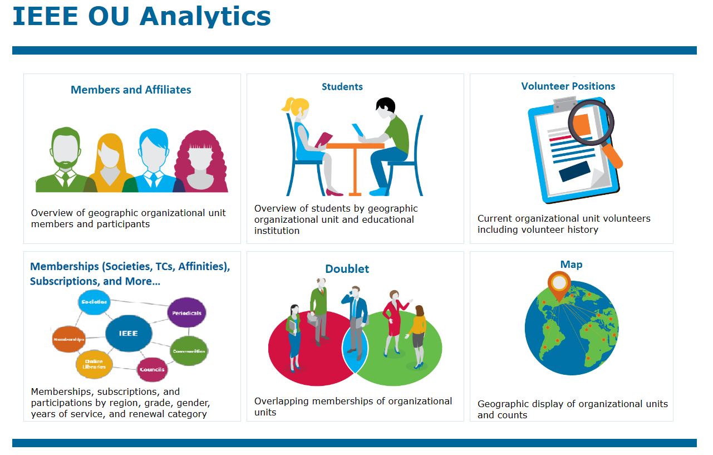
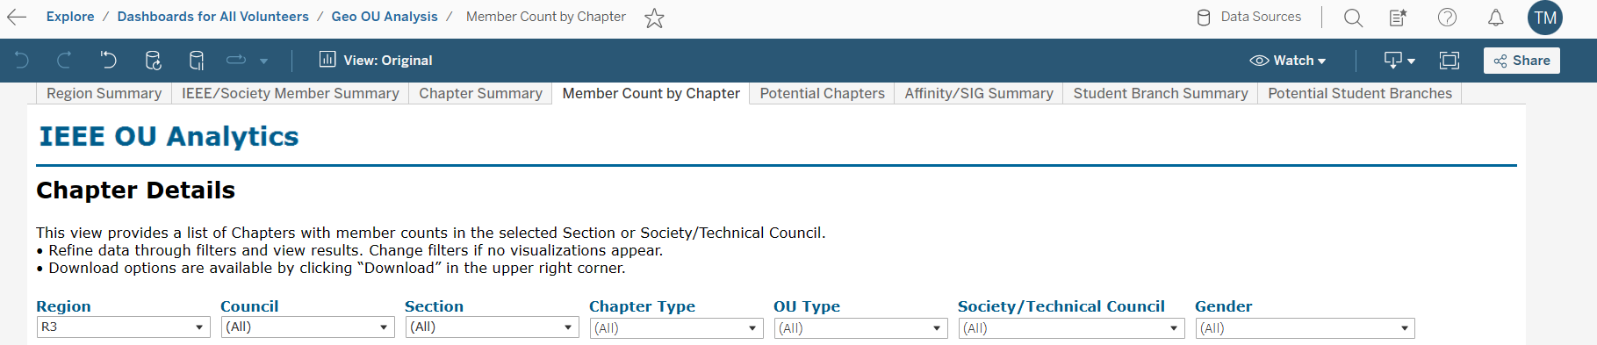
Step 1: Analysis of member data
OU Analytics is your friend
Analyze data to obtain details of potential chapter formation
Understand member participation in local chapter/affinity group activities
Start potential Chapter formation process

Slide 9
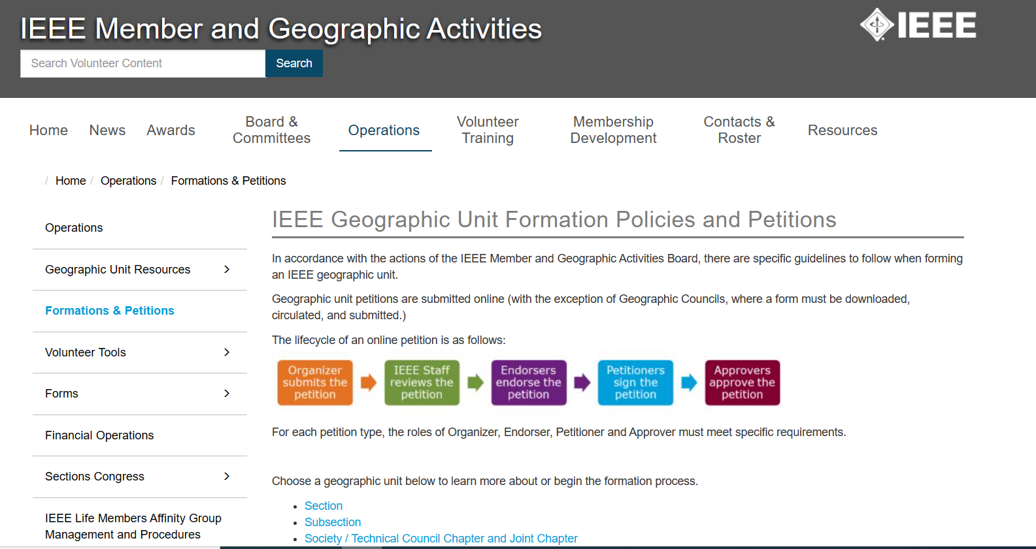
Step 2: Gauge interest for the potential chapter/group formation and start petition
Potential chapter/group can be formed with only 12+ IEEE members
Use vTools to create survey or to send an eNotice for interested volunteers
Follow the petition formation steps
IEEE petition formation tool collects signatures from members of that that chapter/group
Once petition is approved – assign or hold elections for chapter/group officers
https://mga.ieee.org/resources-operations/formations-petitions

Slide 10
Growing Chapters

Slide 11
Tips for chapter/group growth
Sections plays an important role in this process!!
Engage chapter/group officers regularly
Encourage chapters/groups to host more meetings than minimum
Create opportunity to share innovative meeting ideas
Encourage collaboration between chapters/groups within Section and beyond

Slide 12
Support the growing chapters/groups
Section should allocate funds for all active chapters/groups
Encourage chapter/group officers to work closely with their parent societies
Support chapters by sending volunteers to conferences or training
Encourage chapters/groups to host major conferences, summits or standards discussions

Slide 13
Leverage R3 support
R3 executive committees can offer guidance and support to Sections
Reach out to Section Support Committee for training materials or best practices guides
R3 Technical Activities Coordinator can help increase engagement
R3 Member Communication Committee sends out regular Newsletters/eNotices to R3 members

Slide 14
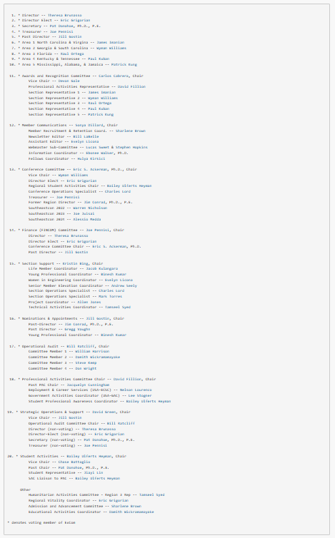
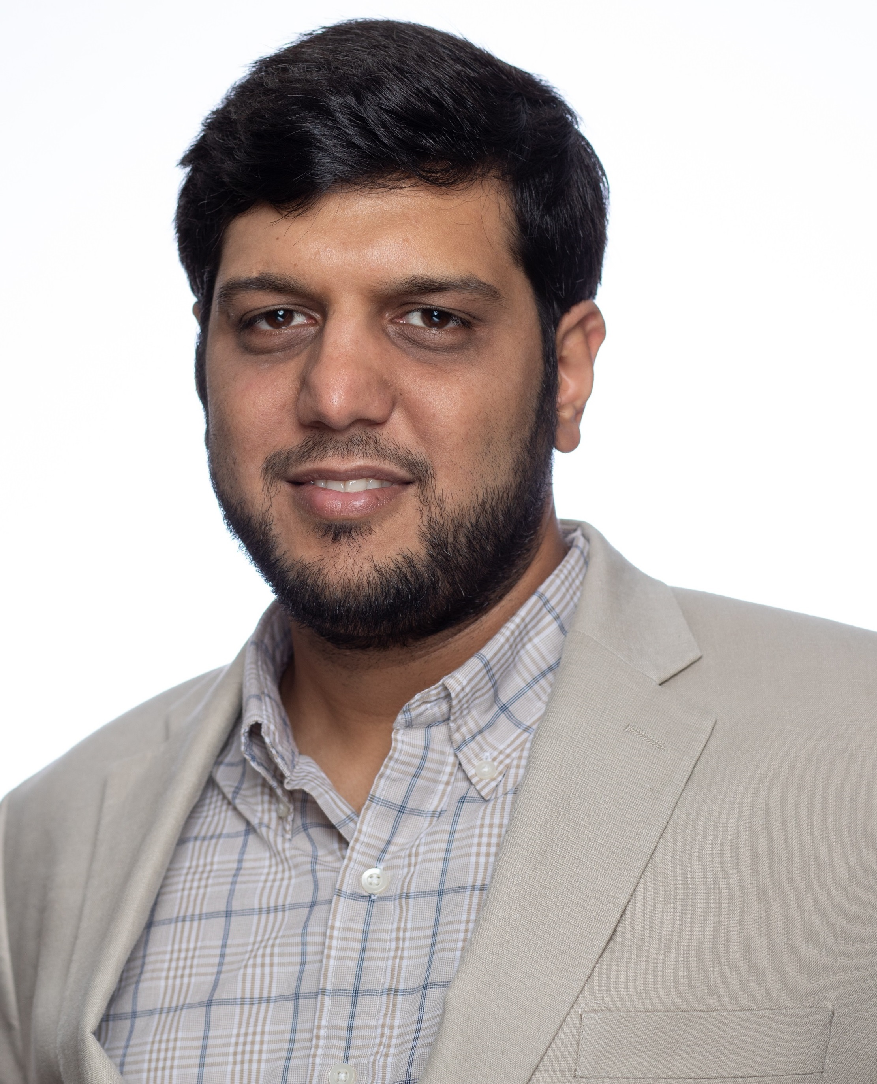
R3 Contact Details
R3 Technical Activities Coordinator:
Mr. Tamseel Syed (syed.tamseel@ieee.org)
https://r3.ieee.org/about

Slide 15
Thank You!
Questions?

